Slide 1
Cell Signaling and Transduction

Slide 2
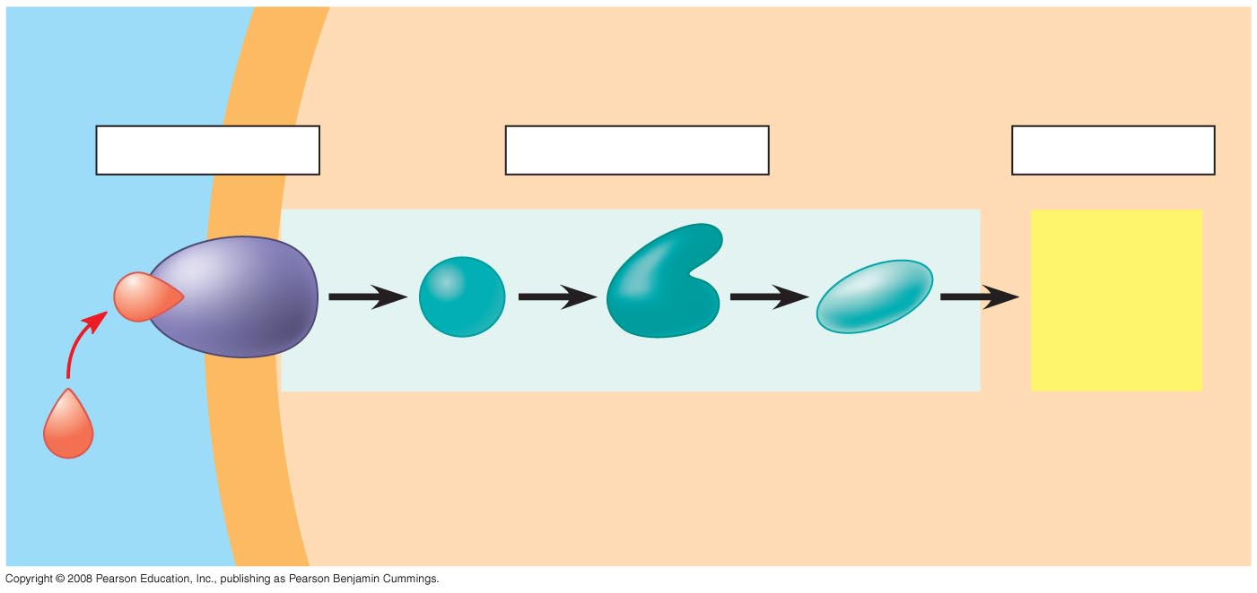
Signal Transduction Pathway
EXTRACELLULAR
FLUID
CYTOPLASM
Plasma membrane
1
Reception
2
Transduction
Amplification of signal
3
Response
Receptor
Activation
of cellular
response
Relay molecules in a signal transduction pathway
Signaling
molecule: ligand
Notes:
Figure 11.6 Overview of cell signaling

Slide 3
Protein Receptors in the Plasma Membrane
Most water-soluble signal molecules bind to specific sites on receptor proteins in the plasma membrane.
There are three main types of membrane receptors:
G protein-coupled receptors
Receptor tyrosine kinases
Ion channel receptors
Copyright © 2008 Pearson Education, Inc., publishing as Pearson Benjamin Cummings

Slide 4
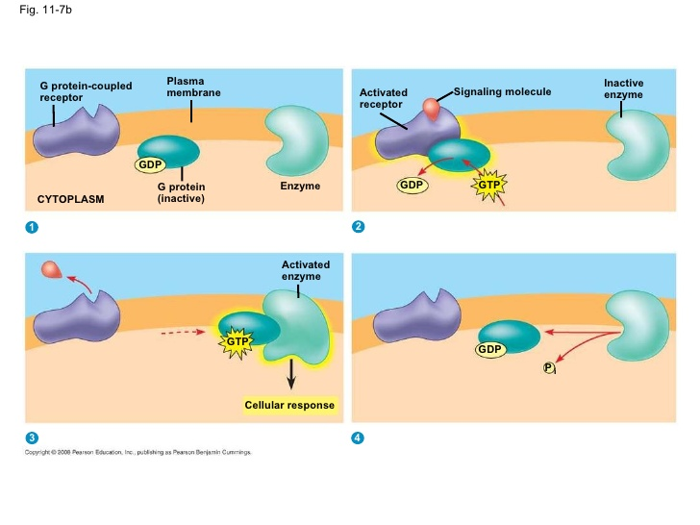
G-Protein Coupled Receptor

Slide 5
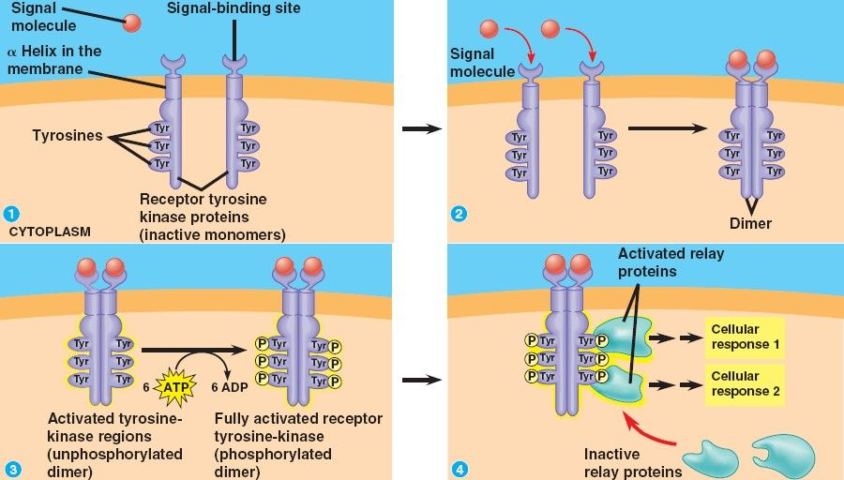
Receptor Tyrosine Kinase

Slide 6
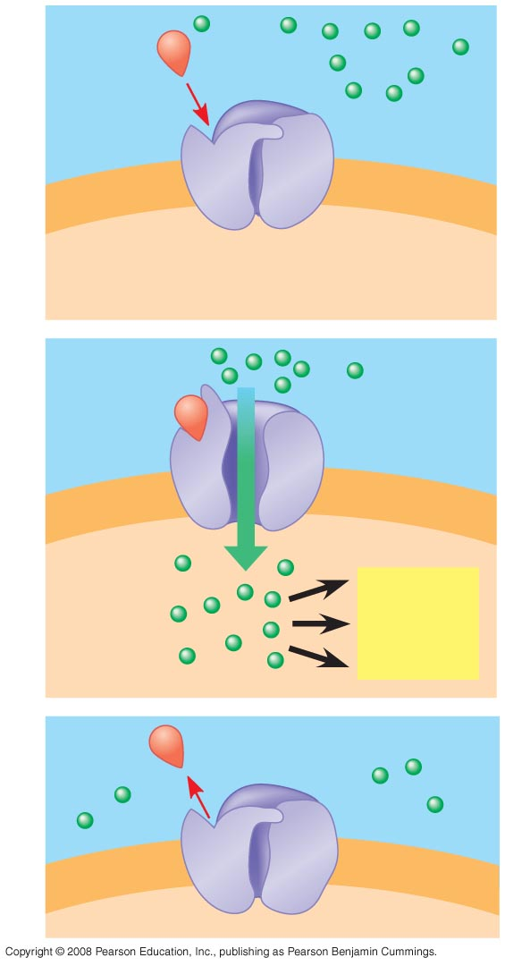
1
Signaling
molecule
(ligand)
Gate
closed
Ions
Ligand-gated
ion channel receptor
Plasma
membrane
2
Gate open
Cellular
response
3
Gate closed
Notes:
Figure 11.7 Membrane receptors—ion channel receptors

Slide 7
Bozeman Video

Slide 8
Transduction: Cascades of molecular interactions relay signals from receptors to target molecules in the cell
Signal transduction usually involves multiple steps.
The molecules that relay a signal from receptor to response are mostly proteins.
Multistep pathways can amplify a signal: A few molecules can produce a large cellular response.
Multistep pathways provide more opportunities for coordination and regulation of the cellular response.
Copyright © 2008 Pearson Education, Inc., publishing as Pearson Benjamin Cummings

Slide 9
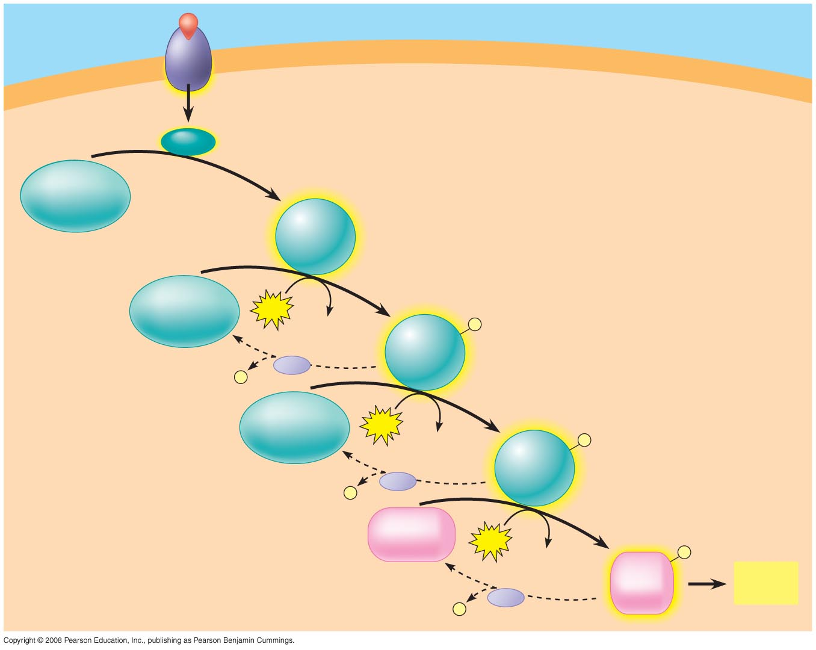
Amplification -- Cascade
Signaling molecule
Receptor
Activated relay
molecule
Inactive
protein kinase
1
Active
protein
kinase
1
Inactive
protein kinase
2
ATP
Phosphorylation cascade
ADP
Active
protein
kinase
2
P
PP
P
i
Inactive
protein kinase
3
ATP
ADP
Active
protein
kinase
3
P
P
PP
i
Inactive
protein
ATP
P
ADP
Active
protein
Cellular
response
PP
P
i
Notes:
Figure 11.9 A phosphorylation cascade

Slide 10
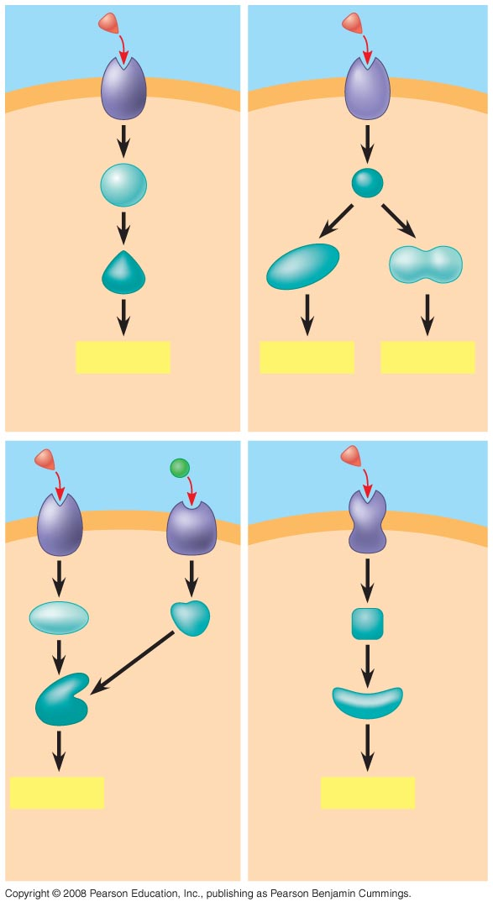
Specificity
of
Cell Signaling
Signaling
molecule
Receptor
Relay
molecules
Response 1
Response 2
Response 3
Cell A. Pathway leads
to a single response.
Cell B. Pathway branches,
leading to two responses.
Activation
or inhibition
Response 4
Response 5
Cell C. Cross-talk occurs
between two pathways.
Cell D. Different receptor
leads to a different response.
Notes:
Figure 11.17 The specificity of cell signaling

