Slide 1
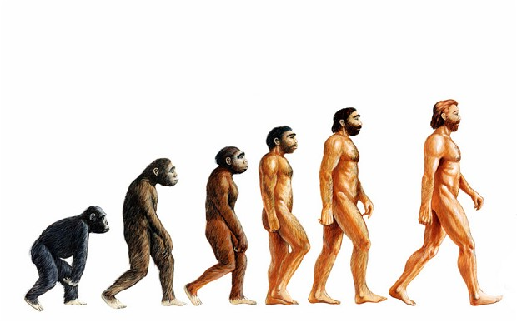
What is wrong with these popular images of evolution?

Slide 2
Caminalcule Questions
Compare your phylogenetic tree to that of two other groups.
What is similar? What is different?
Is one of the trees more correct than the others? Why or why not?
Aside from comparing the anatomy of the caminalcules, what other type(s) of evidence would have been helpful to make your tree as accurate as possible?

Slide 3
More Questions
A lineage is a line of descent from an ancestor.
How many lineages of caminalcules went extinct?
Suggest reasons for the extinction of some of the lineages of caminalcules.
One could argue that some lineages are more successful than others. Give examples of two successful lineages and explain how you know that they were successful.
Is a successful lineage one that has branched many times and is represented by many species, or is it one that has changed least through time? Explain.\
What might some of the next generation of species of caminalcules be like? Describe and then draw two of them.

Slide 4
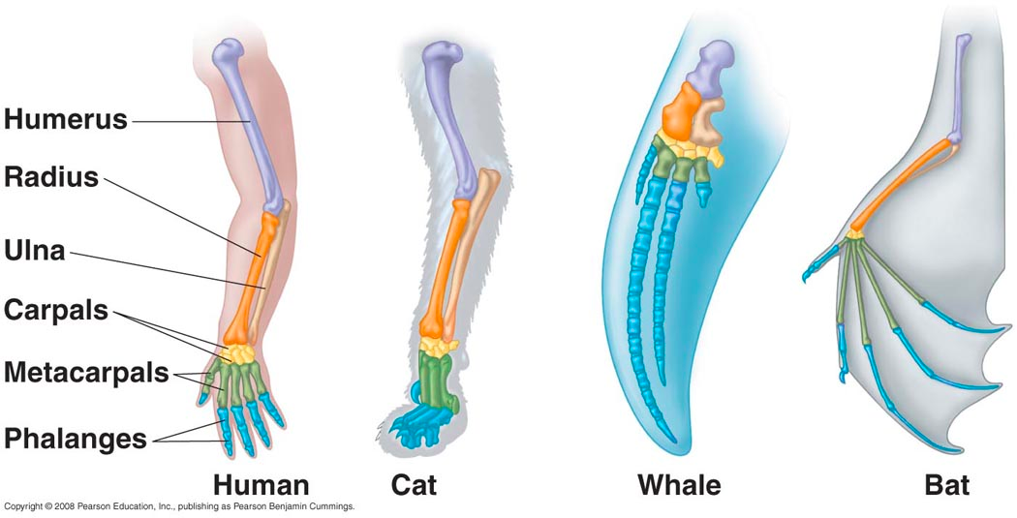
Homology
Similarity due to common ancestor
What evidence of homology do you see in your caminalcules?

Slide 5
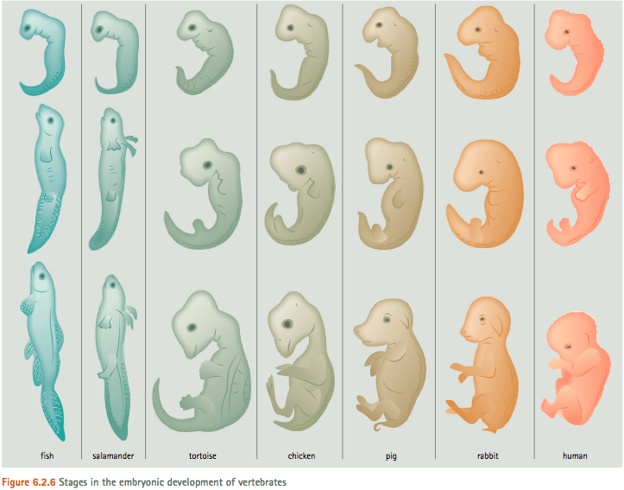
Homology
Structural
Molecular
Embryonic

Slide 6
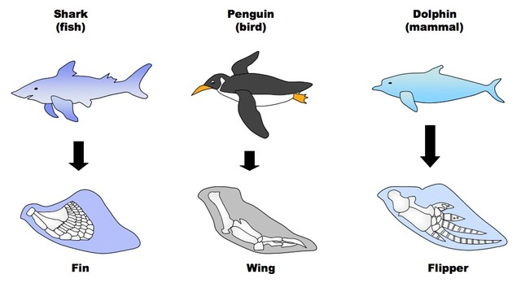
Analogy
Similarity due to similar evolutionary pressure

Slide 7
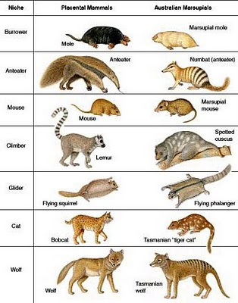
Convergent Evolution
Similar pressures result in similar adaptation
What evidence do you see for convergence in your caminalcules?

Slide 8
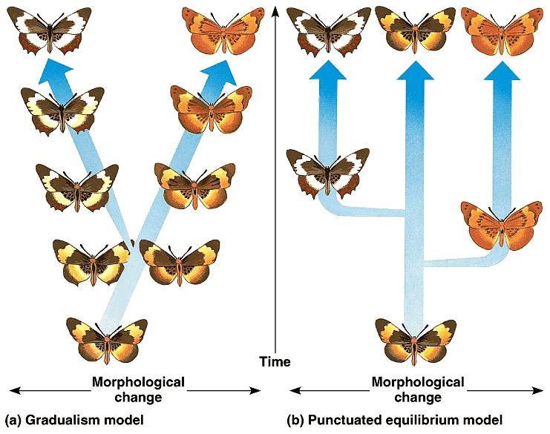
Macroevolution Patterns

Slide 9
Gradualism v. Punctuated Equilibrium
Which do you see in your caminalcules?
Which model makes sense for the history of life?

