Slide 1
Introduction to Biological Molecules: Proteins

Slide 2
Macromolecules are polymers, built from monomers
A polymer is a long chain-like molecule consisting of many similar building blocks.
These small building-block molecules are called monomers.
Three of the four classes of life’s organic molecules are polymers:
Carbohydrates
Proteins
Nucleic acids
Copyright © 2008 Pearson Education, Inc., publishing as Pearson Benjamin Cummings

Slide 3
The Synthesis and Breakdown of Polymers
A condensation reaction or dehydration reaction = two monomers bond together through the loss of a water molecule:
dehydration synthesis = build by removing H-O-H.
Enzymes are catalysts = speed up chemical reactions.
Polymers are broken down to monomers by hydrolysis = breaking down by adding HOH.
Copyright © 2008 Pearson Education, Inc., publishing as Pearson Benjamin Cummings

Slide 4
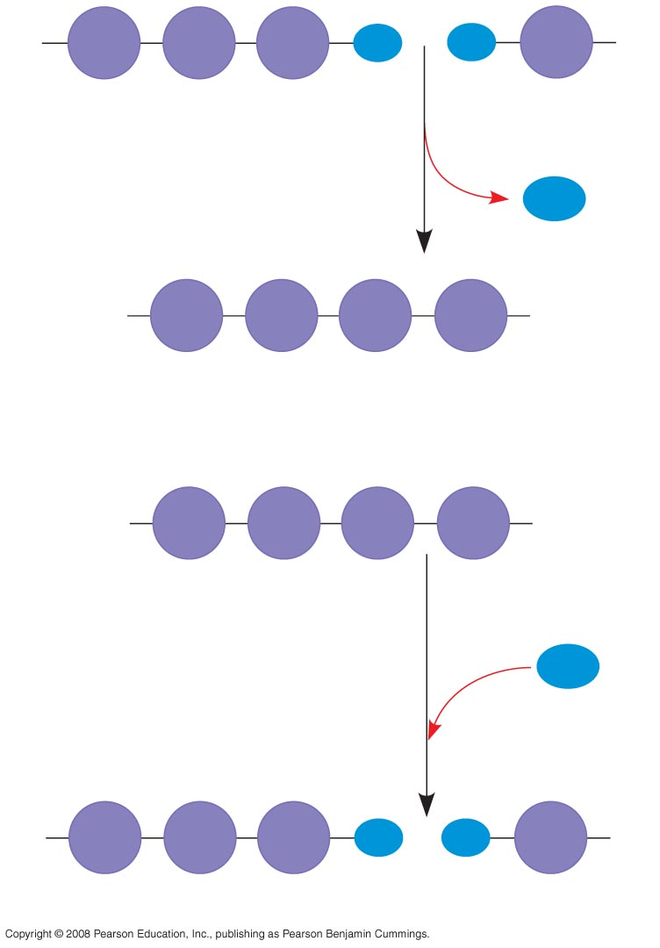
The synthesis and
breakdown of
polymers
HO
1
2
3
H
HO
H
Short polymer
Unlinked monomer
Dehydration removes a water
molecule, forming a new bond
H₂O
HO
1
2
3
4
H
Longer polymer
(a) Dehydration reaction in the synthesis of a polymer
HO
1
2
3
4
H
Hydrolysis adds a water
molecule, breaking a bond
H₂O
HO
1
2
3
H
HO
H
(b) Hydrolysis of a polymer
Notes:
Figure 5.2

Slide 5
The Diversity of Polymers
Each cell has thousands of different kinds of macromolecules.
Macromolecules vary among cells of an organism, vary more within a species, and vary even more between species.
An immense variety of polymers can be built from a small set of monomers.
.2
3
H
HO
Copyright © 2008 Pearson Education, Inc., publishing as Pearson Benjamin Cummings

Slide 6
Proteins have many structures, resulting in a wide range of functions
Proteins account for more than 50% of the dry mass of most cells.
Protein functions include structural support, storage, transport, cellular communications, movement, defense against foreign substances, and organic catalysts (enzymes).
Proteins are polymers called polypeptides.
Amino acids are the monomers used to build proteins.
Copyright © 2008 Pearson Education, Inc., publishing as Pearson Benjamin Cummings

Slide 7
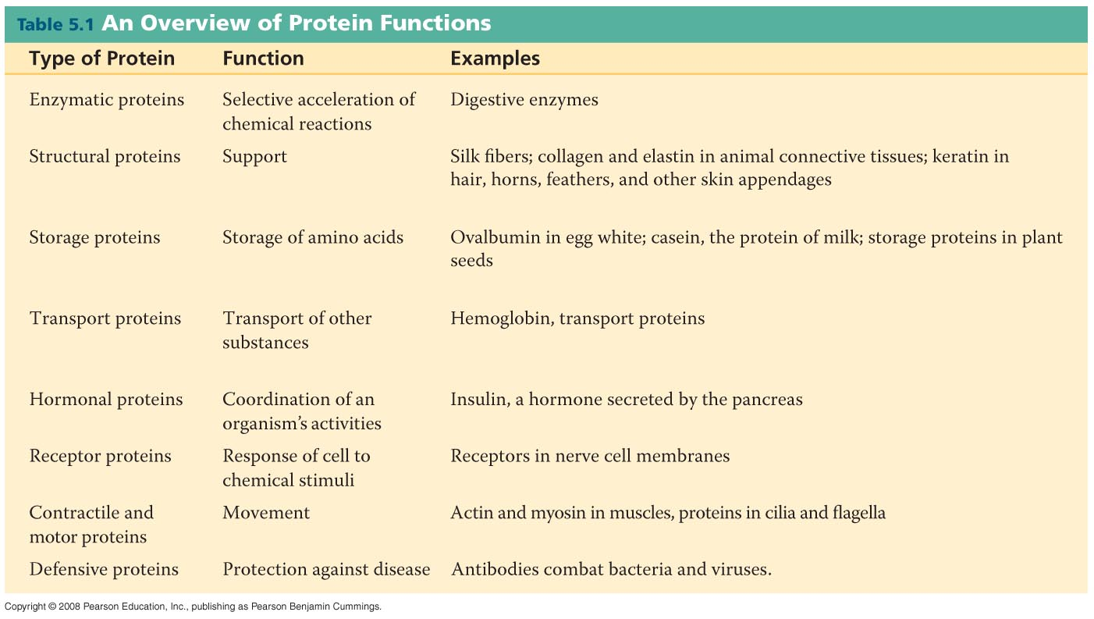
Proteins
Notes:
Table 5-1

Slide 8
Proteins = Polypeptides
Polypeptides are polymers built from a set of 20 amino acids (monomers).
The sequence of amino acids determines a protein’s 3D three-dimensional structure.
A protein’s structure determines its function.
A wide variety of proteins can be made from a few monomers by varying the amino acid sequence.
Copyright © 2008 Pearson Education, Inc., publishing as Pearson Benjamin Cummings

Slide 9
Proteins - Amino Acid Monomers
Amino acids are molecules with carboxyl and amino groups attached to a central carbon.
Amino acids differ due to variable side chains, called R groups
There are 20 different amino acids because there are 20 different side chains.
Copyright © 2008 Pearson Education, Inc., publishing as Pearson Benjamin Cummings

Slide 10
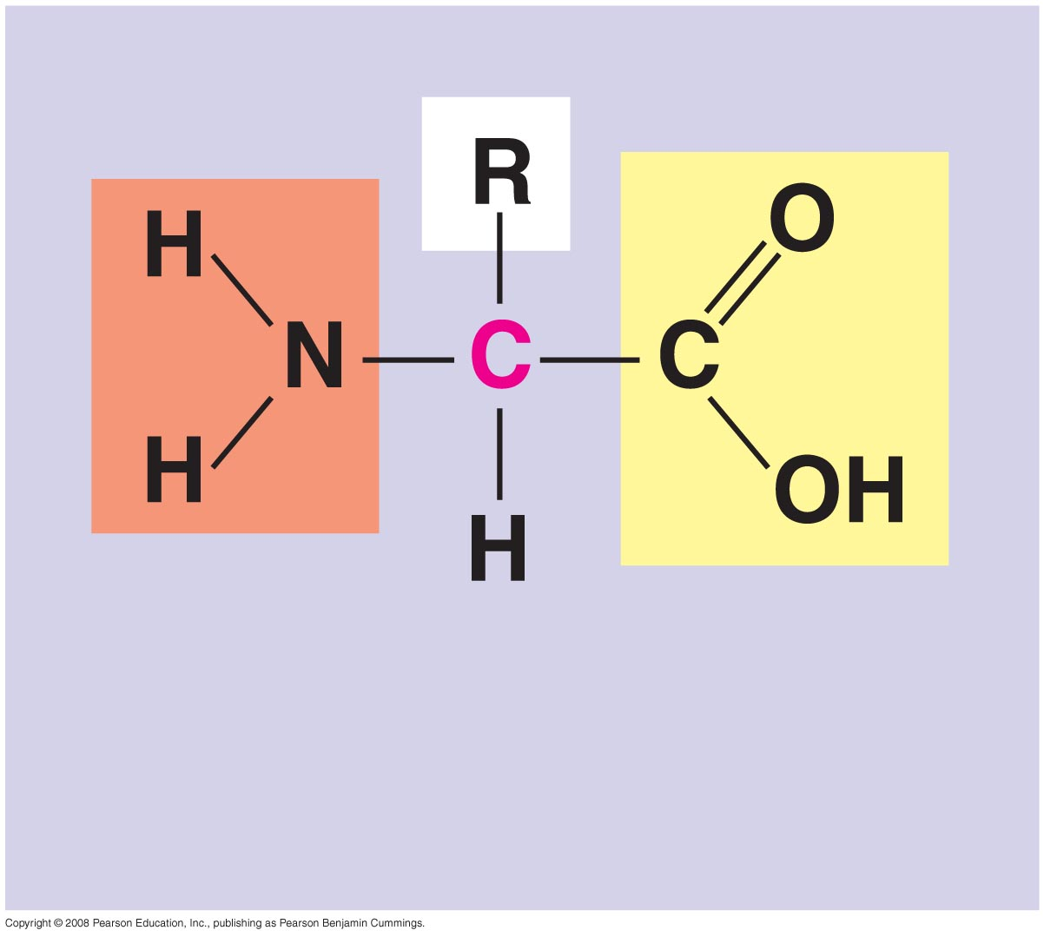
Amino Acid
Amino
group
Carboxyl
group

Slide 11
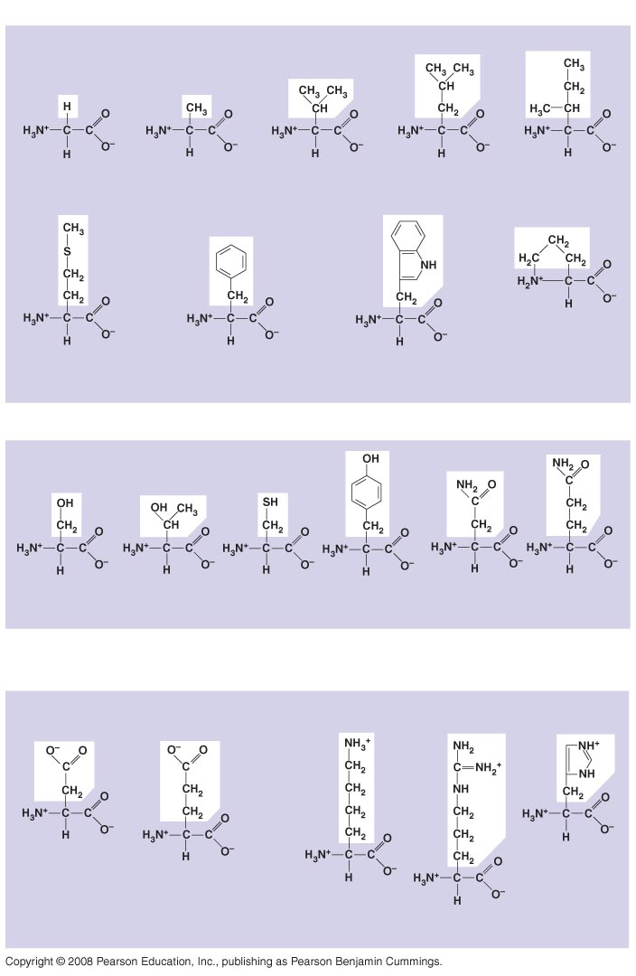
The 20
amino acids
of
proteins
Nonpolar
Glycine
(Gly or G)
Alanine
(Ala or A)
Valine
(Val or V)
Leucine
(Leu or L)
Isoleucine
(Ile or I)
Methionine
(Met or M)
Phenylalanine
(Phe or F)
Trypotphan
(Trp or W)
Proline
(Pro or P)
Polar
Serine
(Ser or S)
Threonine
(Thr or T)
Cysteine
(Cys or C)
Tyrosine
(Tyr or Y)
Asparagine
(Asn or N)
Glutamine
(Gln or Q)
Electrically
charged
Acidic
Basic
Aspartic acid
(Asp or D)
Glutamic acid
(Glu or E)
Lysine
(Lys or K)
Arginine
(Arg or R)
Histidine
(His or H)
Notes:
Figure 5.17

Slide 12
Amino Acid Polymers
Amino acids are linked by covalent bonds called peptide bonds C - N
A polypeptide is a polymer of amino acids.
Polypeptides range in length from a few to more than a thousand monomers.
Each polypeptide has a unique sequence of amino acids.
Copyright © 2008 Pearson Education, Inc., publishing as Pearson Benjamin Cummings

Slide 13
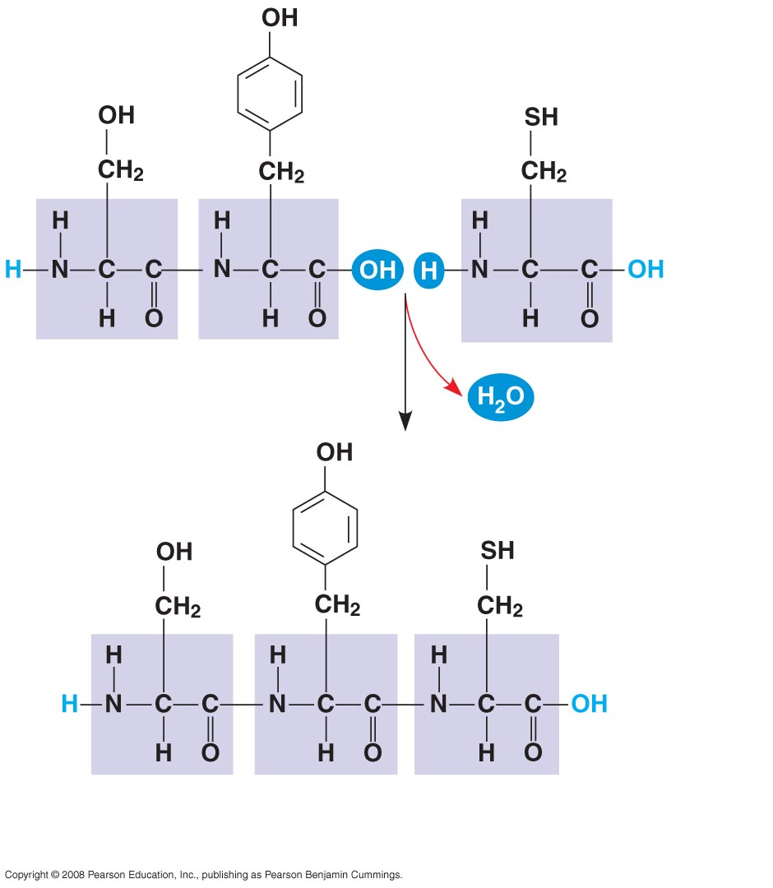
Making a
polypeptide chain
Peptide
bond
(a)
Side chains
Peptide
bond
Backbone
Amino end
(N-terminus)
Carboxyl end
(C-terminus)
(b)
Notes:
Figure 5.18

Slide 14
The sequence of amino acids determines a protein’s three-dimensional structure.
A protein’s structure determines its function.
A functional protein consists of one or more polypeptides twisted, folded, and coiled into a unique shape.
Copyright © 2008 Pearson Education, Inc., publishing as Pearson Benjamin Cummings

Slide 15
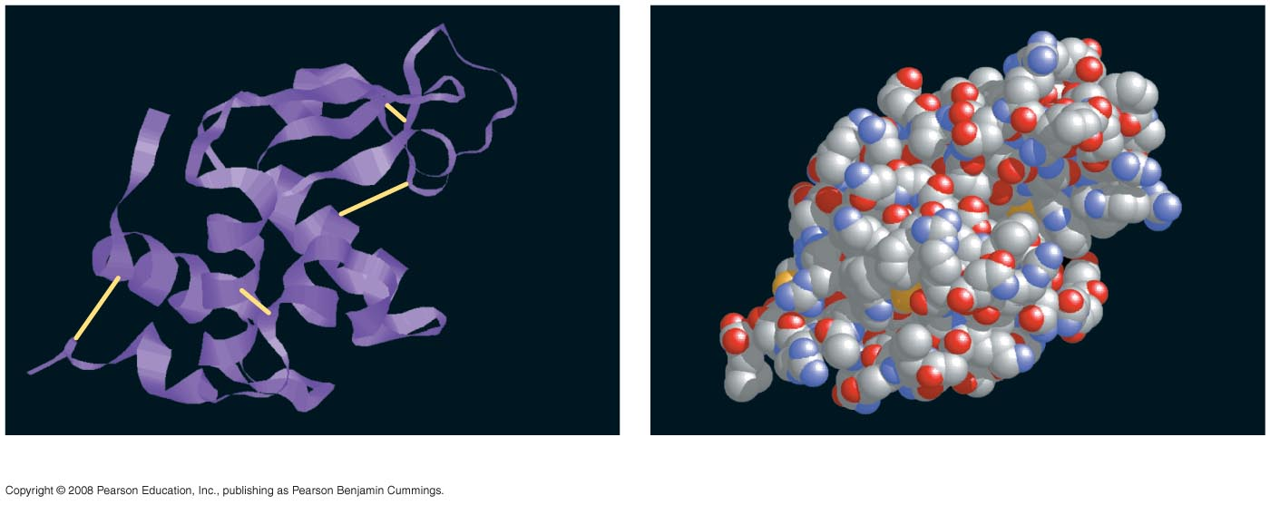
A protein folds into a specific Shape / Structure so it can perform its Function
Groove
Groove
(a)
A ribbon model of lysozyme
(b)
A space-filling model of lysozyme
Notes:
Figure 5.19 Structure of a protein, the enzyme lysozyme

Slide 16
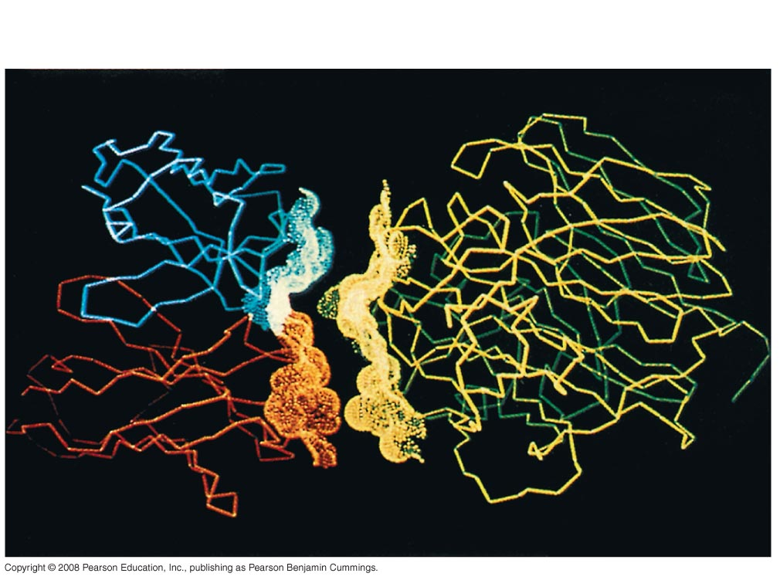
An antibody binding to a protein from a flu virus
Antibody protein
Protein from flu virus
Notes:
Figure 5.20

Slide 17
Four Levels of Protein Structure -- becoming Functional Proteins:
The primary structure of a protein is its unique sequence of amino acids in a polypeptide chain.
Secondary structure consists of regular coils and folds in the polypeptide backbone made by hydrogen bonds.
Tertiary structure is determined by interactions among various side chains R groups.
Quaternary structure results when a protein consists of multiple polypeptide chains.
Copyright © 2008 Pearson Education, Inc., publishing as Pearson Benjamin Cummings

Slide 18
4 Levels of protein structure
Primary
Structure
Secondary
Structure
Tertiary
Structure
Quaternary
Structure
β pleated sheet
⁺H₃N
Amino end
Examples of
amino acid
subunits
α helix
Notes:
Figure 5.21

Slide 19
Primary structure is the sequence of amino acids in a polypeptide chain (protein). This is like the order of letters in a long word.
Primary structure is determined by inherited genetic information (DNA).
Copyright © 2008 Pearson Education, Inc., publishing as Pearson Benjamin Cummings

Slide 20
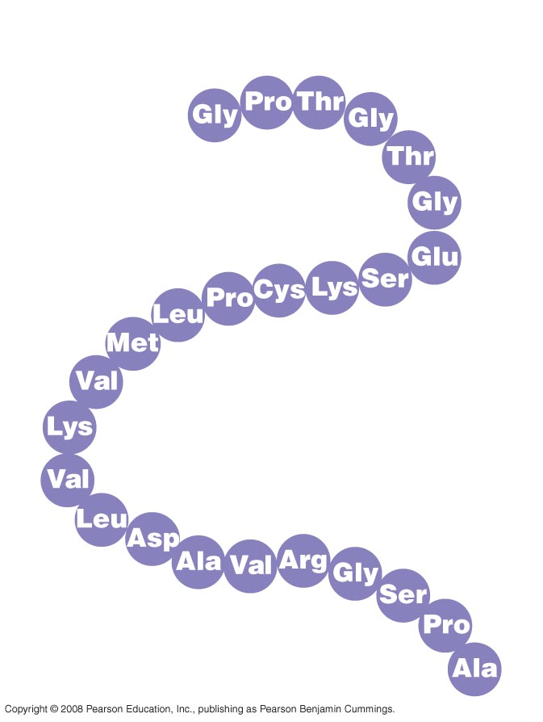
Primary Structure = the Sequence of Amino Acids determined by DNA
Primary Structure
1
⁺H₃N
Amino end
5
10
15
Amino acid
subunits
20
25
Notes:
Figure 5.21 Levels of protein structure—primary structure

Slide 21
The coils and folds of secondary structure result from hydrogen bonds between amino acids.
Typical secondary structures are a coil called an α helix and a folded structure called a β pleated sheet .
Copyright © 2008 Pearson Education, Inc., publishing as Pearson Benjamin Cummings
Notes:
For the Cell Biology Video An Idealized Alpha Helix: No Sidechains, go to Animation and Video Files.
For the Cell Biology Video An Idealized Alpha Helix, go to Animation and Video Files.
For the Cell Biology Video An Idealized Beta Pleated Sheet Cartoon, go to Animation and Video Files.
For the Cell Biology Video An Idealized Beta Pleated Sheet, go to Animation and Video Files.

Slide 22
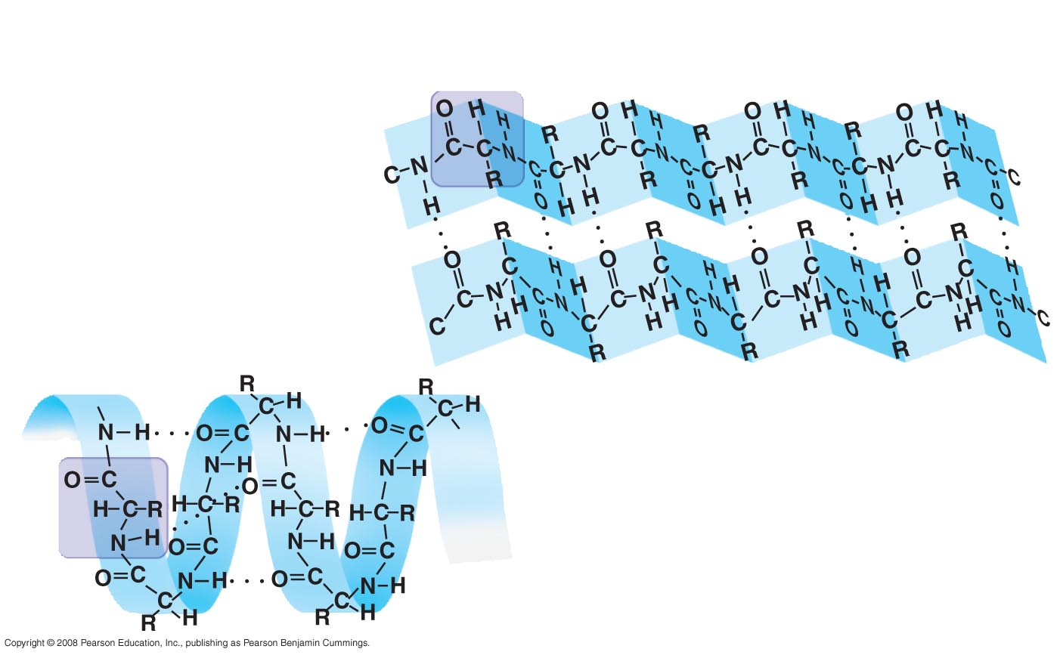
Levels of protein structure—secondary structure
Secondary Structure
β pleated sheet
Examples of
amino acid
subunits
α helix
Notes:
Figure 5.21

Slide 23
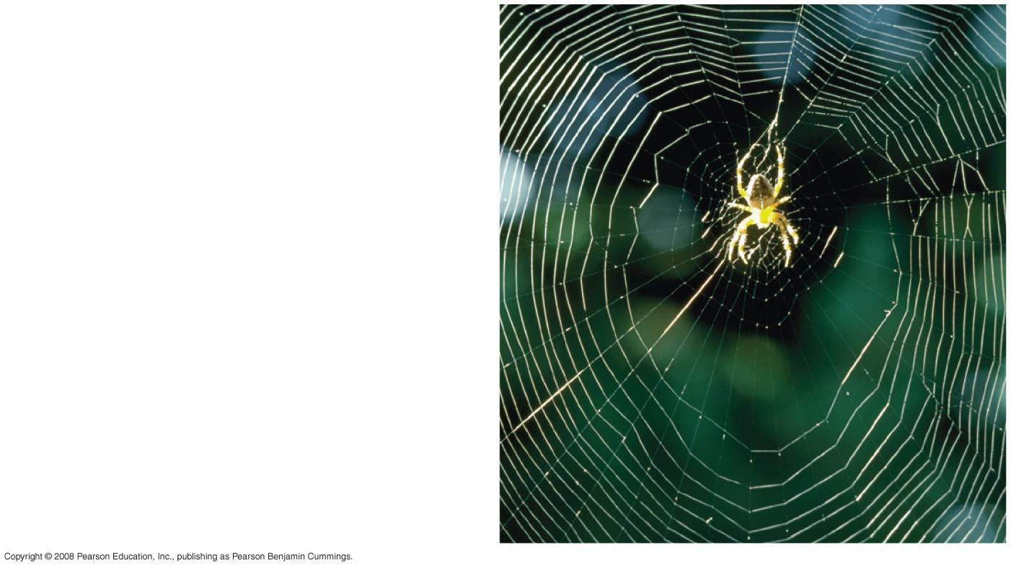
Levels of protein structure—secondary structure
Abdominal glands of the
spider secrete silk fibers
made of a structural protein
containing β pleated sheets.
The radiating strands, made
of dry silk fibers, maintain
the shape of the web.
The spiral strands (capture
strands) are elastic, stretching
in response to wind, rain,
and the touch of insects.
Notes:
Figure 5.21

Slide 24
Tertiary structure is determined by interactions between R groups.
These R group interactions fold the polypeptide into a globular (3-D) shape.
These interactions between R groups include hydrogen bonds, ionic bonds, hydrophobic interactions, and van der Waals interactions. Strong covalent bonds called disulfide bridges may reinforce the protein’s structure.
Copyright © 2008 Pearson Education, Inc., publishing as Pearson Benjamin Cummings

Slide 25
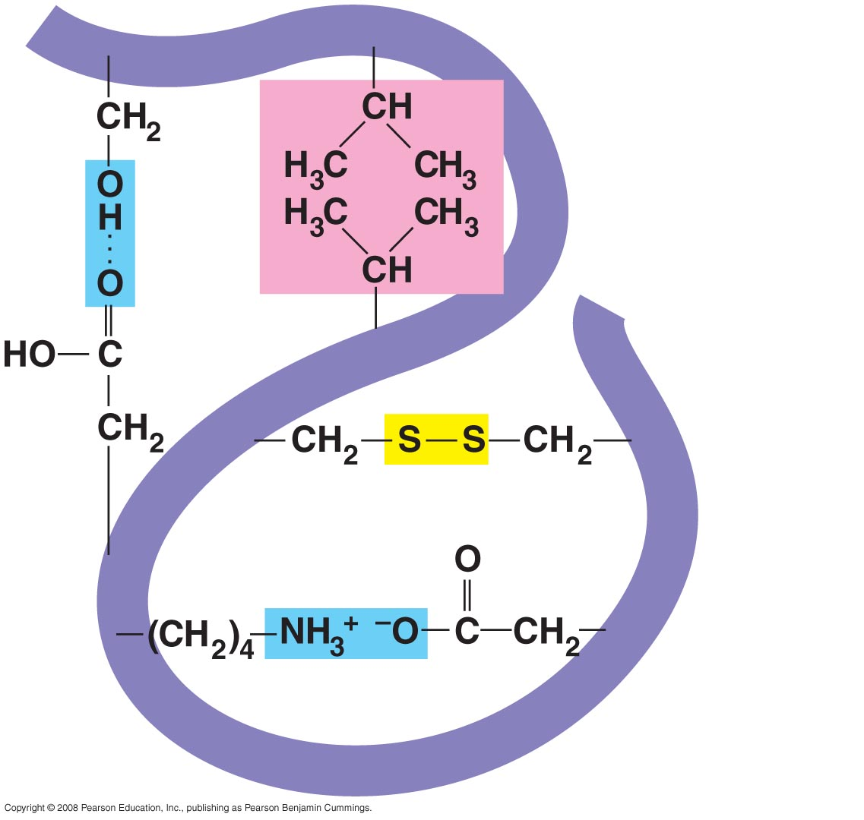
Hydrophobic
interactions and
van der Waals
interactions
Polypeptide
backbone
Hydrogen
bond
Disulfide bridge
Ionic bond
Tertiary Structure
Notes:
Figure 5.21 Levels of protein structure—tertiary and quaternary structures

Slide 26
Quaternary structure results when two or more polypeptide chains form one macromolecule.
Collagen is a fibrous protein consisting of three polypeptides coiled like a rope.
Hemoglobin is a globular protein consisting of four polypeptides: two alpha and two beta chains each with an iron heme group.
Copyright © 2008 Pearson Education, Inc., publishing as Pearson Benjamin Cummings

Slide 27
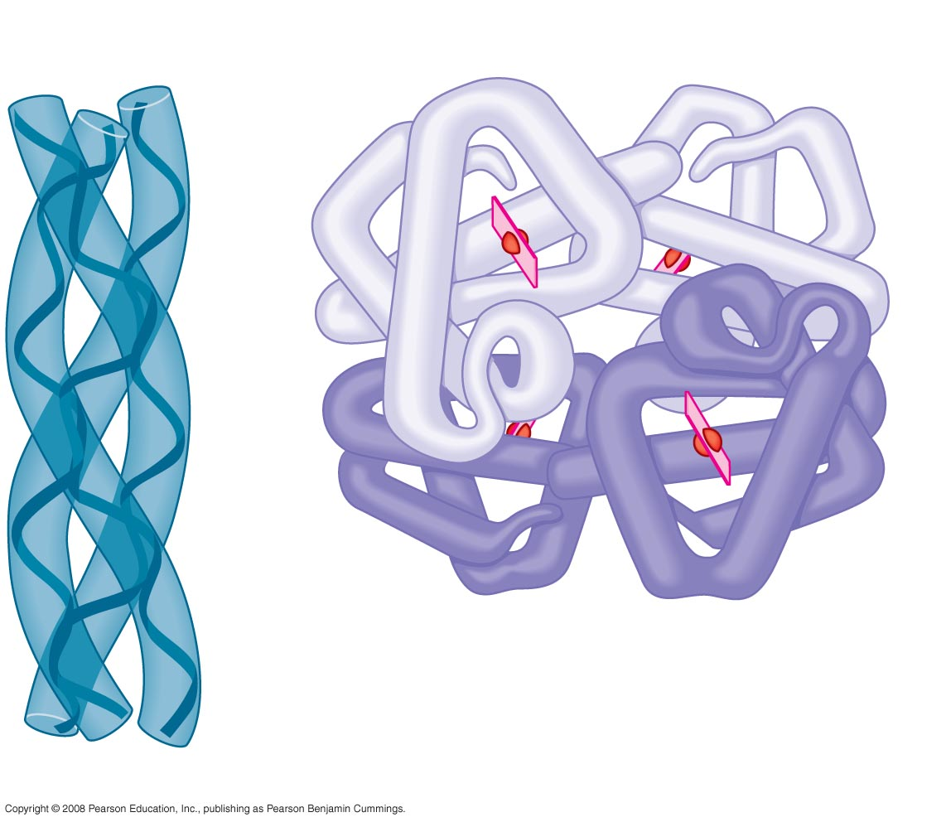
Quaternary structures
Polypeptide
chain
β Chains
Iron
Heme
α Chains
Hemoglobin
Collagen
Notes:
Figure 5.21 Levels of protein structure—tertiary and

Slide 28
Sickle-Cell Disease: A Change in DNA and Primary Structure
A slight change in a proteins DNA can change its primary structure (amino acid sequence). This can affect a protein’s structure and ability to function.
Sickle-cell disease, an inherited blood disorder, results from a single amino acid substitution in the protein hemoglobin.
Copyright © 2008 Pearson Education, Inc., publishing as Pearson Benjamin Cummings

Slide 29
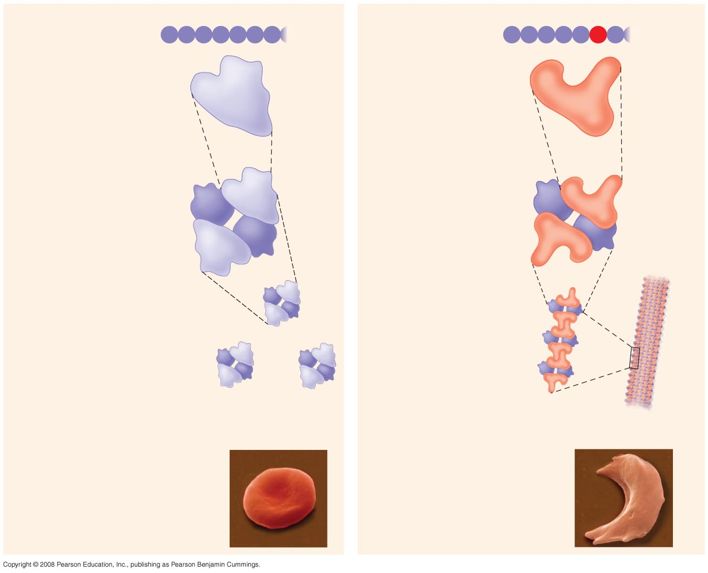
A single amino acid substitution in a protein causes sickle-cell disease
Normal hemoglobin
Primary
structure
Sickle-cell hemoglobin
Primary
structure
Val
His
Leu
Thr
Pro
Glu
Glu
Val
His
Leu
Thr
Pro
Val
Glu
1
2
3
4
5
6
7
1
2
3
4
5
6
7
Secondary
and tertiary
structures
Secondary
and tertiary
structures
Exposed
hydrophobic
region
β subunit
β subunit
α
β
α
Quaternary
structure
Normal
hemoglobin
(top view)
Quaternary
structure
Sickle-cell
hemoglobin
β
β
α
β
α
Function
Molecules do
not associate
with one
another; each
carries oxygen.
Function
Molecules
interact with
one another and
crystallize into
a fiber; capacity
to carry oxygen
is greatly reduced.
10 µm
10 µm
Red blood
cell shape
Normal red blood
cells are full of
individual
hemoglobin
moledules, each
carrying oxygen.
Red blood
cell shape
Fibers of abnormal
hemoglobin deform
red blood cell into
sickle shape.
Notes:
Figure 5.22

Slide 30
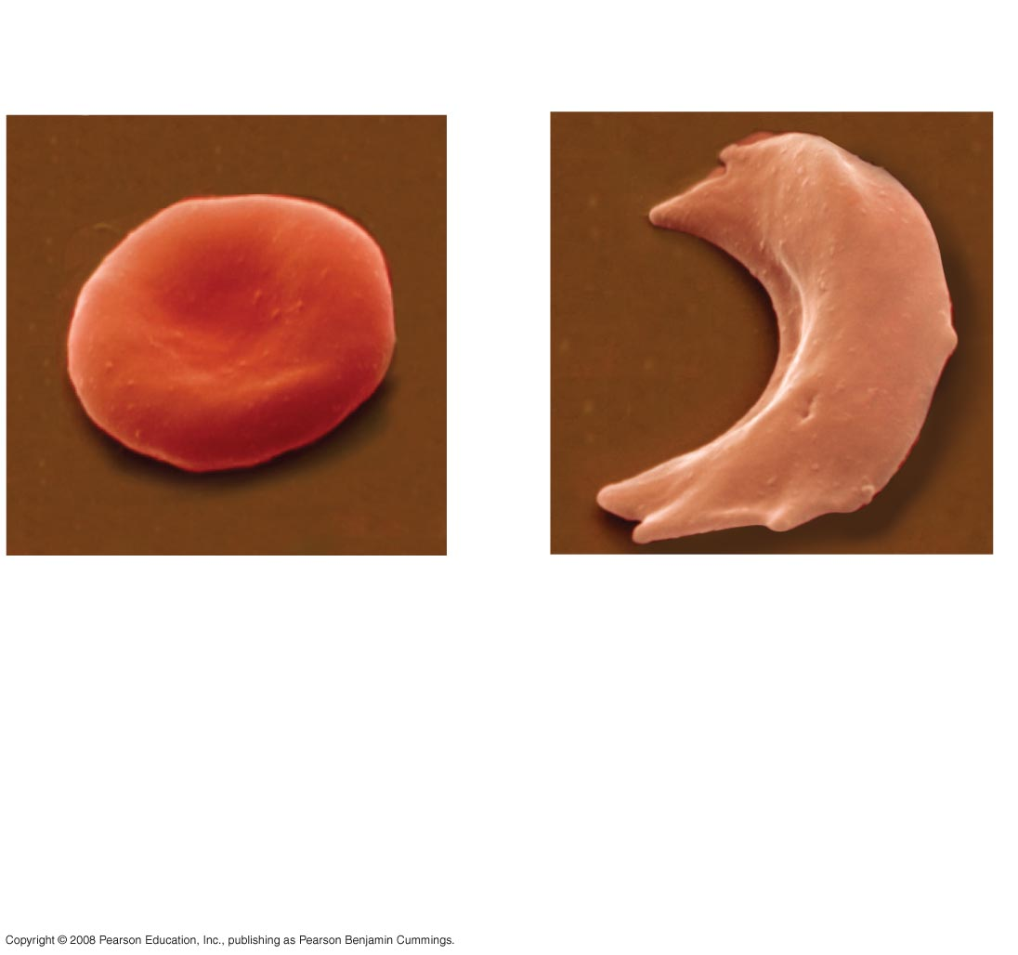
A single amino acid substitution in a protein causes sickle-cell disease
10 µm
10 µm
Normal red blood
cells are full of
individual
hemoglobin
molecules, each
carrying oxygen.
Fibers of abnormal
hemoglobin deform
red blood cell into
sickle shape.
Notes:
Figure 5.22 A single amino acid substitution in a protein causes sickle-cell disease

Slide 31
Environmental Factors Affect Protein Structure
In addition to primary structure, physical and chemical conditions can affect protein structure.
Alterations in pH, salt concentration, temperature, or other environmental factors can cause a protein to unravel and loose its native shape.
This shape change is called denaturation.
A denatured protein is biologically inactive.
Copyright © 2008 Pearson Education, Inc., publishing as Pearson Benjamin Cummings

Slide 32
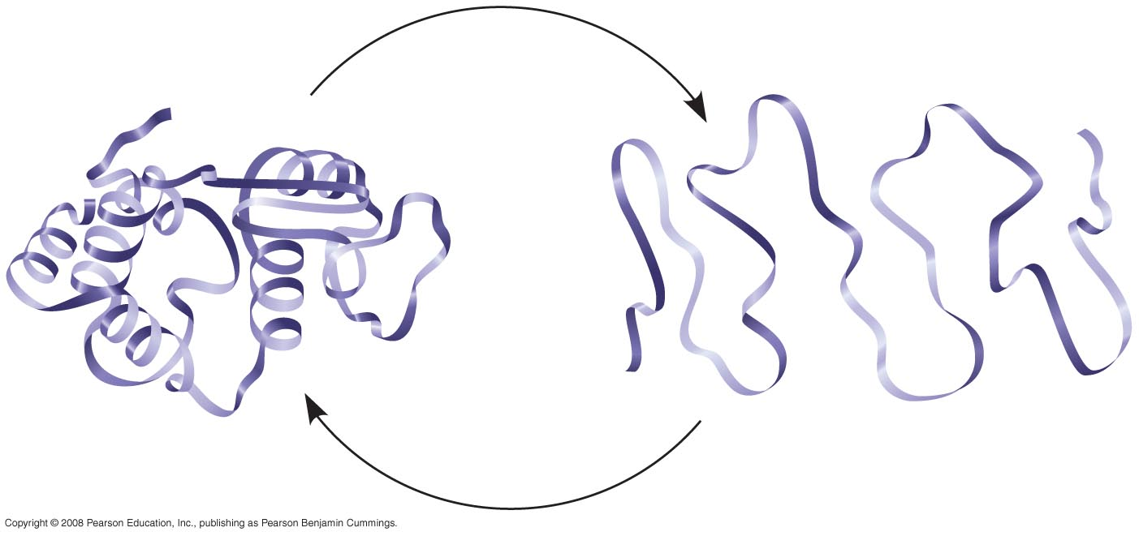
Denaturation and renaturation of a protein
Denaturation
Normal protein
Renaturation
Denatured protein
Notes:
Figure 5.23

Slide 33
Protein Folding in the Cell
It is hard to predict a protein’s structure from its primary structure.
Most proteins probably go through several states on their way to a stable structure.
Chaperonins are protein molecules that assist the proper folding of other proteins.
Copyright © 2008 Pearson Education, Inc., publishing as Pearson Benjamin Cummings

Slide 34
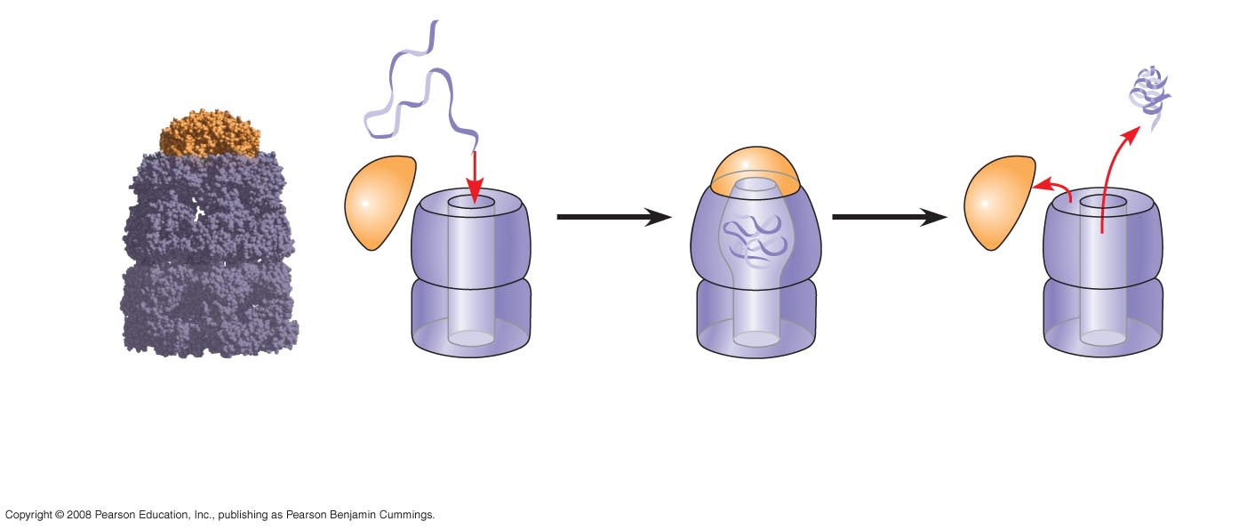
Protein Folding in a cell: a chaperonin in action
Correctly
folded
protein
Polypeptide
Cap
Hollow
cylinder
Chaperonin
(fully assembled)
Steps of Chaperonin
Action:
2
The cap attaches, causing the
cylinder to change shape in
such a way that it creates a
hydrophilic environment for
the folding of the polypeptide.
3
The cap comes
off, and the properly
folded protein is
released.
1
An unfolded poly-
peptide enters the
cylinder from one end.
Notes:
Figure 5.24

