Slide 2
5. SEX-LINKED TRAITS
Females: X X
Males: X Y

Slide 3
5. SEX-LINKED TRAITS
Traits controlled by genes on the X chromosome.
Mostly affects males because they have one X chromosome.
Females are less affected because they have 2 X chromosomes.

Slide 4
Colorblind Test

Slide 5
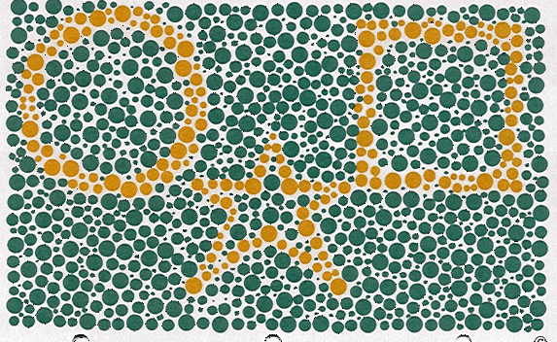

Slide 11
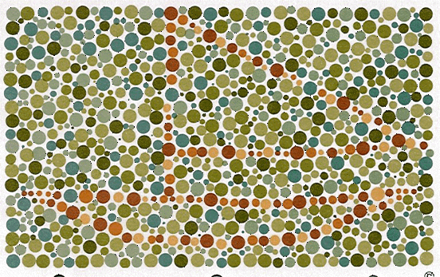

Slide 12
Colorblindness
What Causes Colorblindess?
Malfunction/absence of cone cells which
detect red, green, blue light.
Genetic
Sex-Linked (on X-chromosome)

Slide 13
Colorblindness
X X
X Y
<1 % females
Colorblind
10 % males
Colorblind

Slide 14
Ex) Red-Green Colorblindess
Possible Alleles:
X^{B} = Normal
X^{b} = Red-Green Color Blindness
Y = Y Chromosome

Slide 15
List the possible phenotypes of a cross between a normal vision male with a female carrier.
X^{B} Y x X^{B} X^{b}
X^{B} Y
X^{B} X^{B} | X^{B} Y
X^{B} X^{b} | X^{b} Y
X^{B}
X^{b}

Slide 16
Is it possible for a healthy male to have healthy children with a female who has the recessive disorder Muscular Dystrophy?
X^{M} Y x X^{m} X^{m}
X^{M} Y
X^{M} X^{m} | X^{m} Y
X^{M} X^{m} | X^{m} Y
X^{m}
X^{m}

Slide 17
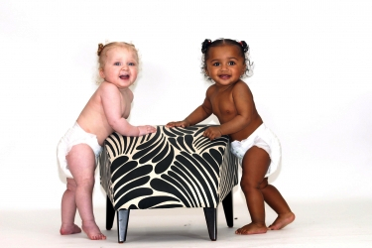
COMPLEX INHERITANCE
Mendel’s Law of Independent Assortment:
Genes on separate chromosomes sort independently during Meiosis.

Slide 18
6. DIHYBRID CROSS
Monohybrid Cross: Punnett Square for one trait
ex) Pea Shape
Dihybrid Cross: Punnett Square for 2 traits
ex) Pea shape & color

Slide 19
R = Round
r = wrinkled
Y = Yellow
y = green
The alleles for Pea Color and Pea Shape sort independently of one another.

Slide 20
Dihybrid Practice
R= round, r= wrinkled, Y=yellow, y= green
Cross a plant green peas that is heterozygous for shape with a plant that is heterozygous for both alleles.

Slide 21
Trihybrid
R= round, r= wrinkled
Y=yellow, y= green
V= venomous, v= nonvenomous
Cross two plants that are heterozygous for all alleles. What are the genotype and phenotype ratios?

Slide 22
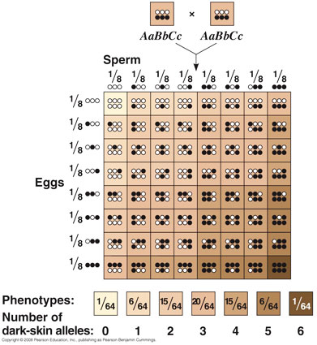
7. POLYGENIC (multiple genes)
Many genes contribute to one trait.
Ex. Skin color, height

Slide 23
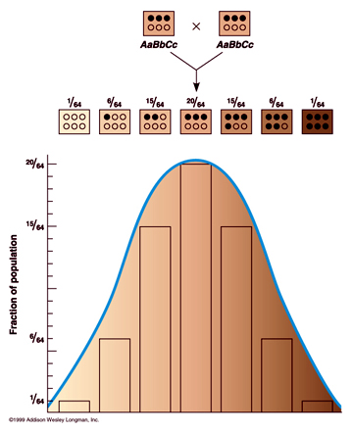
Polygenic inheritance
Assuming random mating, a wide range of phenotypes are possible (bell curve)

Slide 24
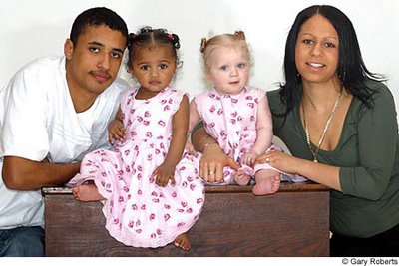
Polygenic Inheritance
Explain how this is possible:

Slide 25
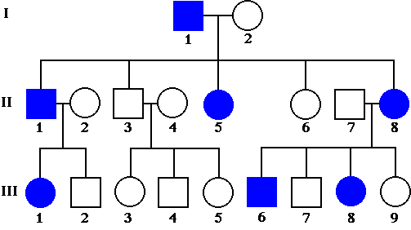
PEDIGREES
Charts used to track the inheritance of traits in a family
= Female
= Male
Colored shapes
represent people
who express the
trait.

Slide 26
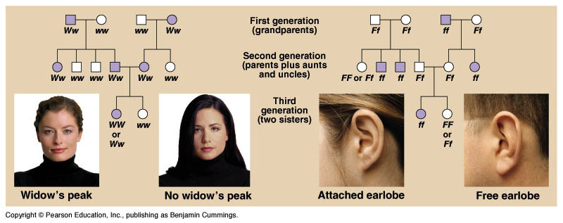
DOMINANT WIDOW’S PEAK PEDIGREE
W = Widow’s Peak
w = No Peak

Slide 27
RECESSIVE EARLOBE PEDIGREE
F = Free Earlobe
f = Attached

Slide 28
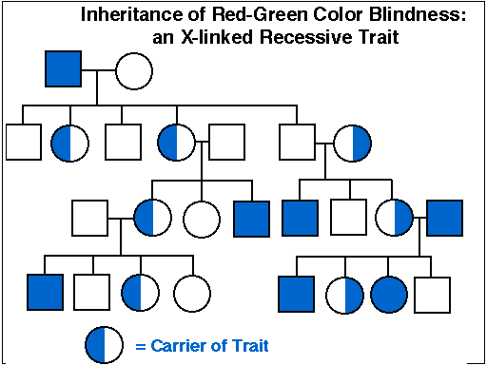
X-Linked Trait
Carriers can be shown with half colored box

