Slide 1
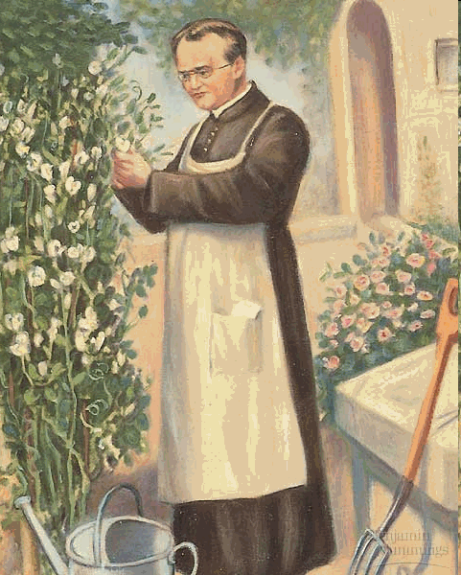
GREGOR MENDEL
Austrian monk 1822-1884
Bred pea plants and studied inheritance of traits

Slide 2
MENDELIAN GENETICS
Traits are inherited through genes, segments of DNA on a chromosome.
We inherit genes in pairs
(1 from mom, 1 from dad)
Alleles are alternative versions of a gene
Notes:
1843 Augustinian Monestary, studied 3 years, failed teacher test
Studied Math in Vienna
Grew pea plants in 1857

Slide 3
MENDELIAN GENETICS
Self Pollination = A plant fertilizes itself

Slide 4
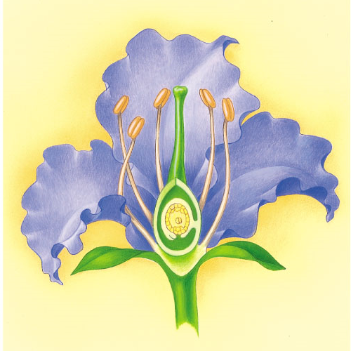
MENDELIAN GENETICS
Cross-Pollination = A plant fertilizes another plant

Slide 5
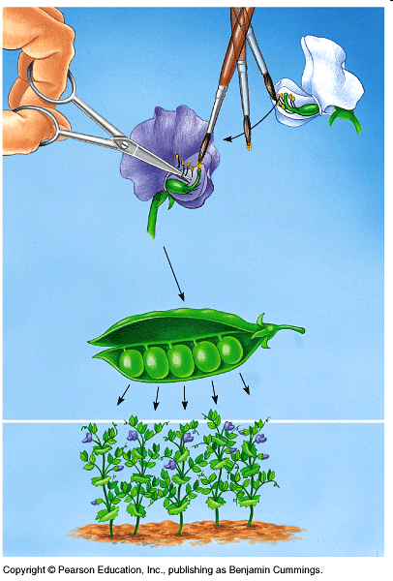

Slide 6
1. P (parental) Generation Cross-Pollinate 2 True-Breeding plants to make a hybrid
MENDEL’S EXPERIMENT
2. F₁ (First filial) Generation Self-Pollinate the Hybrid
3. F₂ (Second filial) Generation Observe ratio of offspring:
Always a 3:1 Ratio

Slide 7
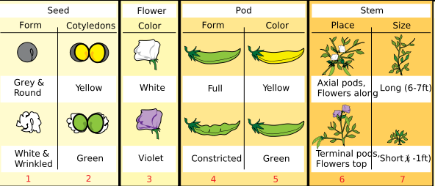
MENDEL’S EXPERIMENT
Mendel repeated his experiment for the
following traits:
Always a 3:1 Ratio ! !

Slide 8
ALLELES
Alleles are alternative versions of a gene
Height Gene from Dad
Height Gene from Mom
= short version
= tall version
= short allele
= tall allele

Slide 9
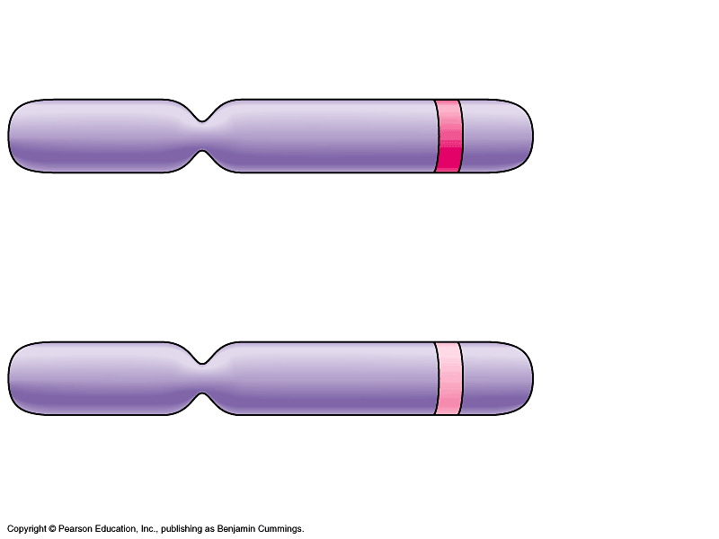
ALLELE COMBINATIONS
There are 2 alleles for the flower color gene:
Purple or White
3 possible combinations to be inherited:
Homozygous Dominant
Heterozygous
Homozygous Recessive

Slide 10
PRINCIPLE OF DOMINANCE
Dominant Allele: The allele that is expressed
Recessive Allele: The allele that is not expressed in a heterozygous individual

Slide 11
GENOTYPE & PHENOTYPE
Genotype: The allele combination of an organism
ex) Homozygous Dominant
Heterozygous
Homozygous Recessive
Phenotype: The observable characteristics of an organism
ex) Brown Eyes

Slide 12
GENOTYPE DETERMINES PHENOTYPE

Slide 13
MENDEL’S LAW OF SEGREGATION
Two alleles for a gene in a diploid cell will separate into the gamete cells during Meiosis

Slide 14
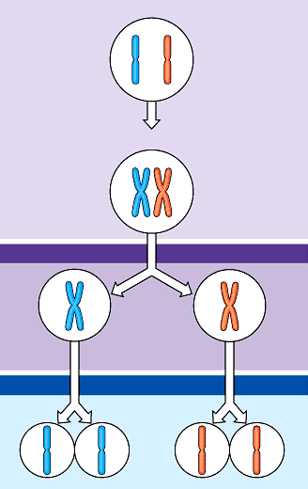
MENDEL’S LAW OF SEGREGATION
Diploid
Parent Cell
MEIOSIS
Haploid
Gamete Cell

Slide 15
MENDEL’S LAW OF SEGREGATION
Diploid
Parent Cell
b
B
b
b
B
B
MEIOSIS
b
b
B
B
Haploid
Gamete Cell
b
b
B
B

Slide 16
MOM
DAD
b
B
b
B
b
b
B
B
b
b
B
B
b
b
B
B
b
b
B
B
b
b
B
B
b
b
B
B
Egg cells
Sperm Cells

Slide 17
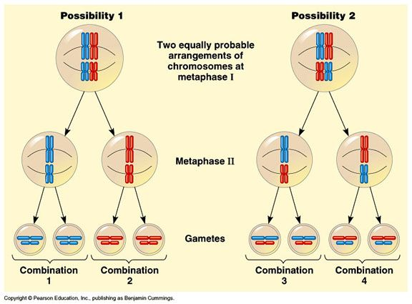
MENDEL’S LAW OF INDEPENDENT ASSORTMENT
Alleles separate independently of each other during meiosis.

Slide 18
Punnett Squares
A diagram used to predict the offspring of a cross between 2 known genotypes.
Male gamete possibilities are written on top
Female gamete possibilities are written on the side
The male/female gamete combinations are written inside the boxes

Slide 19
Punnett Squares
Ex) Cross a Brown-eyed Heterozygous male (Bb)
and a Brown-eyed Heterozygous female (Bb)
B
b
B
BB
Bb
b
Bb
bb

Slide 20
Punnett Squares
Ex) Cross a Tongue Rolling Homozygous male (TT)
and a non-Tongue Rolling Homozygous female (tt)
T
T
t
Tt
Tt
t
Tt
Tt

Slide 21
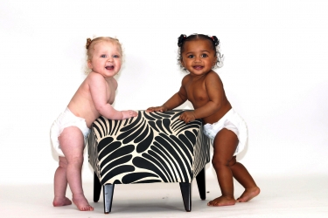
COMPLEX INHERITANCE

Slide 22
1. INCOMPLETE DOMINANCE
When a mixture of phenotypes is expressed in a heterozygous organism.
Ex) Pink Snapdragons
R R
r r
A heterozygous genotype is pink instead of red.
R r

Slide 23
Practice
Cross a pink and a red snapdragon. What are the genotype and phenotype ratios if the offspring?

Slide 24
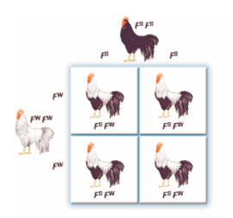
2. CODOMINANCE
When both phenotypes are expressed in a heterozygous organism
Use two uppercase alleles with superscript to show difference.
Ex)Black, white, and barred chickens

Slide 25
Practice
Cross a black chicken (F^{B}F^{B)} with a barred chicken (F^{B}F^{W}). What are the genotype and phenotype ratios of the offspring?

Slide 26
3. MULTIPLE ALLELES
More than two alleles may exist for a trait in a population, which increases the genotype and phenotype possibilities in a population.
ex) 3 Blood Type Alleles (I^{A} , I^{B}, i)

Slide 27
Blood Type Information
Phenotype | Genotype | Anti-body Produced
Type A Type B Type AB Type O | I^{A} I^{A or} I^{A} i I^{B} I^{B or} I^{B} i I^{A} I^{B} i i | Anti-B Anti-A None Anti-A & Anti-B

Slide 28
Ex) Cross a Heterozygous Type A male and a Heterozygous
Type B female

Slide 29
Ex) Cross a Heterozygous Type A male and a Heterozygous
Type B female
I^{A}
i
I^{B}
i

Slide 30
Ex) Cross a Heterozygous Type A male and a Heterozygous
Type B female
I^{A}
i
I^{B}
I^{A}
I^{B}
I^{B}
i
i
I^{A}
i
i
i

Slide 31
4. GENE LINKAGE
Chromosomes contain many genes
Genes that are close together on a chromosome are considered “linked” because they usually travel together during Meiosis (gamete formation)

Slide 32
Eye color
Hair color
Eye color
Hair color
Eye color
Hair color
Eye color
Hair color

