Slide 1
Graphing Data

Slide 2
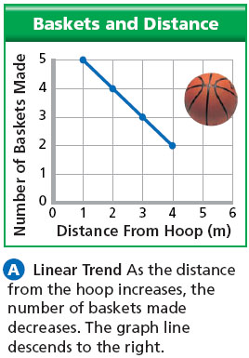
Why is graphing important?
Graphing data helps us visualize trends and make predictions about the system.
What trend do you notice?
What prediction would you make about the number of baskets made from 6m?

Slide 3
Types of Variables
Quantitative: This is a number or something you can measure directly. Examples might include time, distance, temperature or height. (See quantity– think number)
Qualitative: This is descriptive data. It describes, but is not numerical. Examples might include color, species, gender or brand. (See quality– think descriptive
The type of data you collect will determine what type of graph you should make.

Slide 4
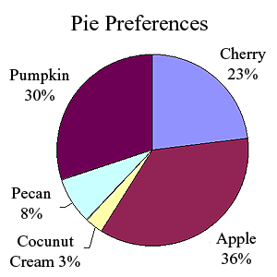
Pie Chart
These show percentages of a whole. These should ONLY be used when data is collected as a PERCENT.

Slide 5
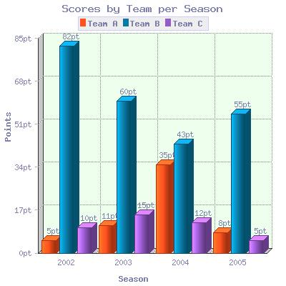
Bar Graphs
Used when data is quantitative v. qualitative
Visually displays information using a series of bars, rectangles, or objects

Slide 6
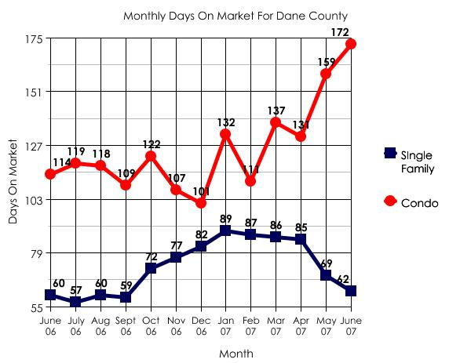
Line Graphs
Used when data is quantitative v. quantitative
Measured data is plotted as points which can then be connected.

Slide 7
How to make a good graph
It’s in the D-TAILS!

Slide 8
D-TAILS
Data covers over 75% of the graph area and is accurately placed.
NO!!!
YES!!!

Slide 9
D-TAILS
Title includes what the graph is about and both the independent and dependent variables
Effect of Hours of Sleep on Quiz Scores

Slide 10
D-TAILS
Axis labels- Independent variable is always on the X-axis and the dependent variable is always on the Y-axis
Effect of Hours of Sleep on Quiz Scores
Quiz Scores
Sleep

Slide 11
D-TAILS
Interval marks- consistent spacing and numbering
Effect of Hours of Sleep on Quiz Scores
100
75
Quiz Scores
50
25
0
0 1 2 3 4 5 6 7 8
Sleep

Slide 12
D-TAILS
Label units- in ( ) after the axis label, include proper units.
Effect of Hours of Sleep on Quiz Scores
100
75
Quiz Scores (%)
50
25
0
0 1 2 3 4 5 6 7 8
Sleep (hrs)

Slide 13
D-TAILS
Scale-
Always go by an even scale.
Ex: 1,2,3,4
NOT
1,2,4,8
Effect of Hours of Sleep on Quiz Scores
100
75
Quiz Scores (%)
50
25
0
0 1 2 3 4 5 6 7 8
Sleep (hrs)

Slide 14
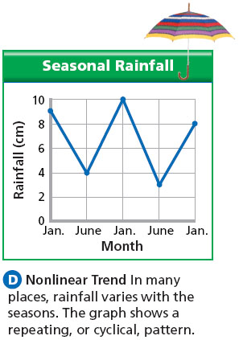
Drawing lines
If the x-axis is time, you can simply connect your points.

Slide 15
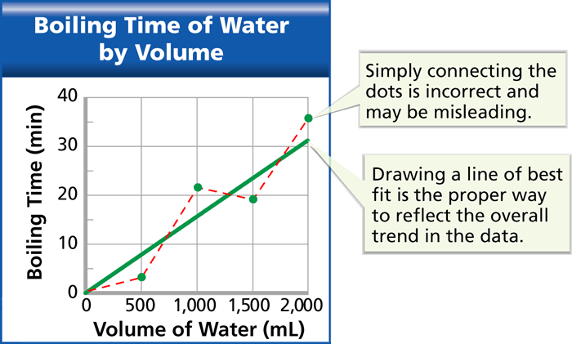
Line of Best Fit
If your X-axis is not time, then use a line of best fit in line graphs.
A line of best fit emphasizes the overall trend shown by all the data taken as a whole.

