Slide 1
Global Climate and Biomes

Slide 2
Climate: temperature, water, sunlight, and wind
Four major abiotic components of climate are temperature, water, sunlight, and wind.
The long-term prevailing weather conditions in an area constitute its climate.
Macroclimate consists of patterns on the global, regional, and local level.
Microclimate consists of very fine patterns, such as those encountered by the community of organisms underneath a fallen log.

Slide 3
Seasonal variations of light and temperature increase steadily toward the poles.
Global air circulation and precipitation patterns play major roles in determining climate patterns.
Warm wet air flows from the tropics toward the poles.

Slide 4
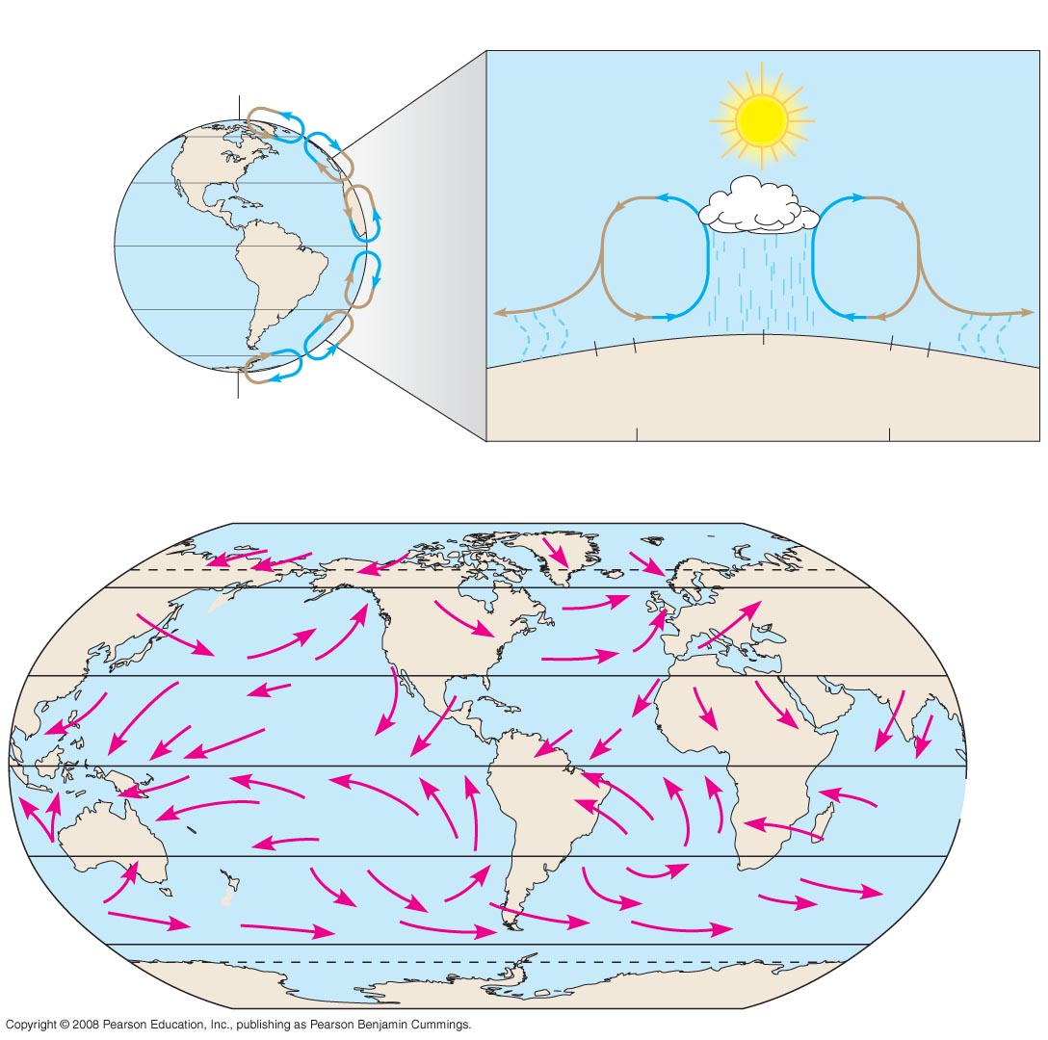
Global climate patterns
Global Air Circulation and Precipitation Patterns
60ºN
30ºN
Descending
dry air
absorbs
moisture
Descending
dry air
absorbs
moisture
0º (equator)
Ascending
moist air
releases
moisture
30ºS
60ºS
30º
23.5º
0º
23.5º
30º
Arid
zone
Tropics
Arid
zone
Global Wind Patterns
66.5ºN
(Arctic Circle)
60ºN
Westerlies
30ºN
Northeast trades
Doldrums
0º
(equator)
Southeast trades
30ºS
Westerlies
60ºS
66.5ºS
(Antarctic Circle)
Notes:
Figure 52.10 Global climate patterns

Slide 5
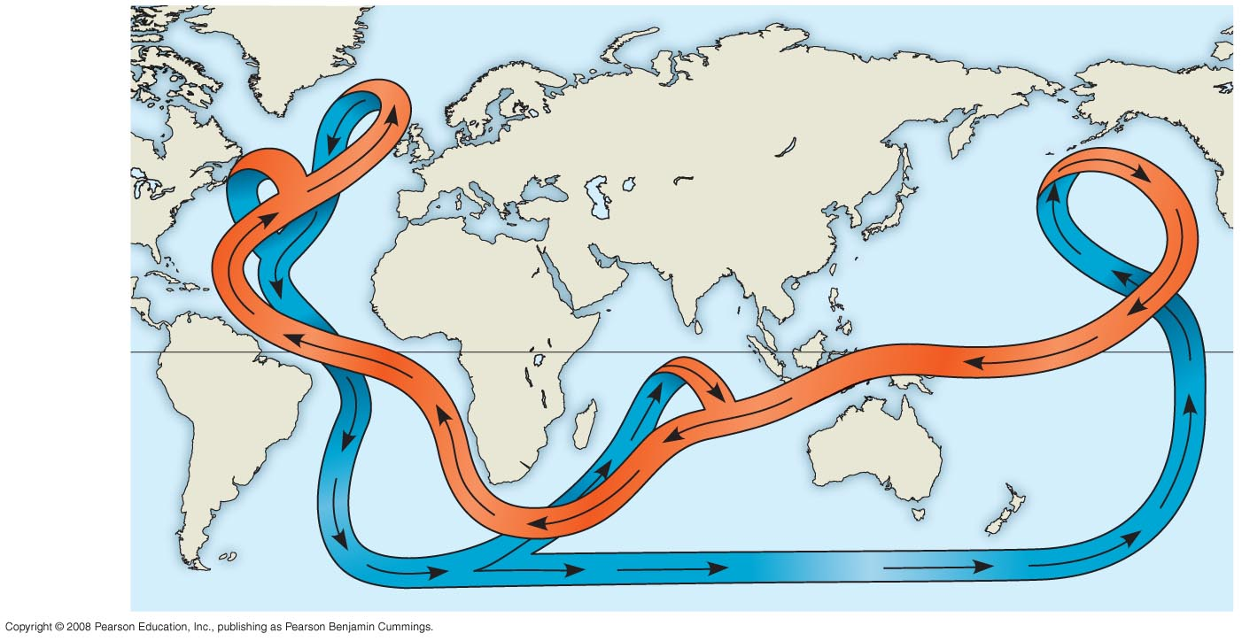
The great ocean conveyor belt: Cold Current = Labrador / Warm = Gulf Stream
Labrador
current
Gulf
stream
Equator
Warm
water
Cold water
Notes:
Figure 52.11 The great ocean conveyor belt

Slide 6
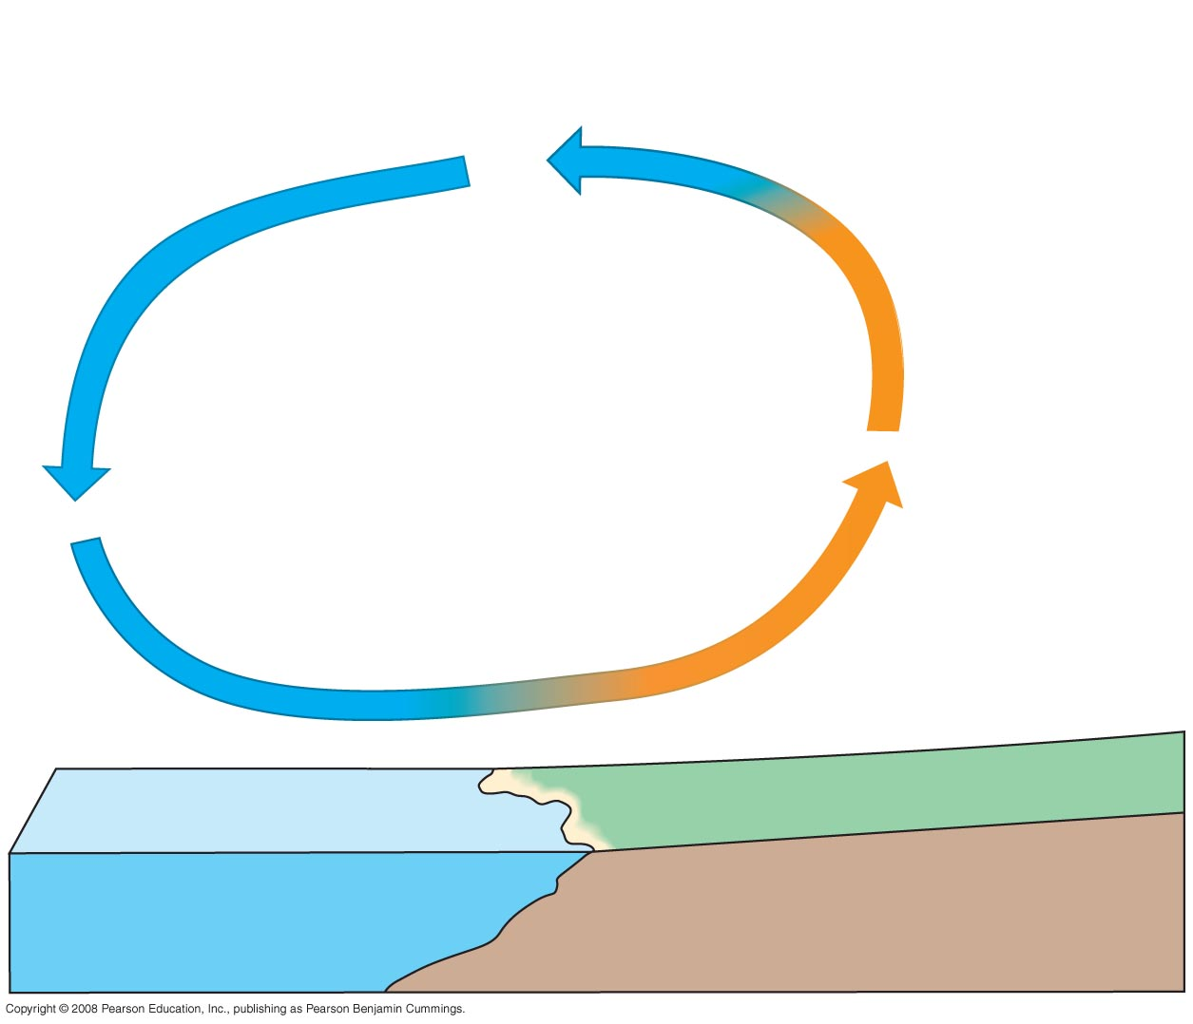
2
Air cools at
high elevation.
Cooler
air sinks
over water.
3
Warm air
over land rises.
1
Cool air over water
moves inland, replacing
rising warm air over land.
4
Moderating effects of a large body of water on climate
Notes:
Figure 52.12 Moderating effects of a large body of water on climate

Slide 7
Mountains
Mountains have a significant effect on:
The amount of sunlight reaching an area
Local temperature
Rainfall
Rising air releases moisture on the windward side of a peak and creates a “rain shadow” as it absorbs moisture on the leeward side.

Slide 8
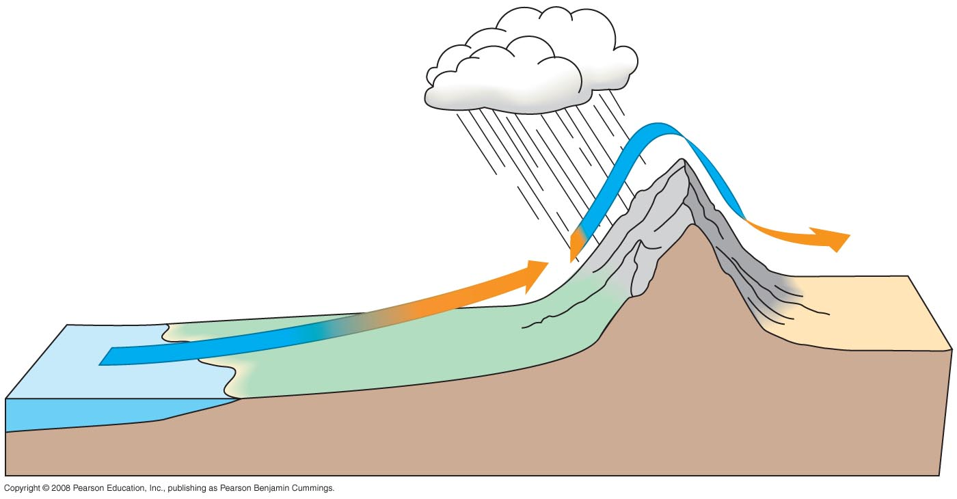
How mountains affect rainfall
Leeward side
of mountain
Wind
direction
Mountain
range
Ocean
Notes:
Figure 52.13 How mountains affect rainfall

Slide 9
Aquatic biomes are diverse and dynamic systems that cover 75% of the Earth
Biomes are the major ecological associations that occupy broad geographic regions of land or water.
Varying combinations of biotic and abiotic factors determine the nature of biomes.
Aquatic biomes account for the largest part of the biosphere in terms of area. They can contain fresh water or salt water (marine).
Many aquatic biomes are stratified into zones or layers defined by light penetration, temperature, and depth.

Slide 10
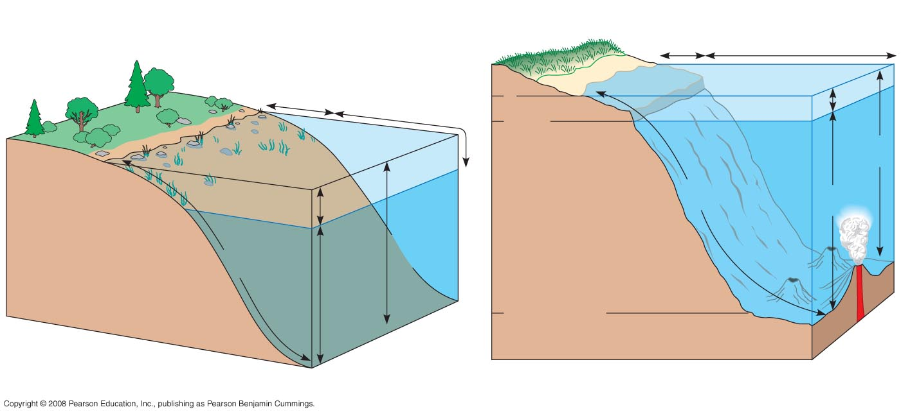
Zonation in Aquatic Environments
Intertidal zone
Neritic zone
Oceanic zone
Littoral
zone
Limnetic
zone
0
Photic zone
200 m
Continental
shelf
Pelagic
zone
Photic
zone
Benthic
zone
Aphotic
zone
Benthic
zone
Pelagic
zone
Aphotic
zone
2,000–6,000 m
Abyssal zone
(a) Zonation in a lake
(b) Marine zonation
Notes:
Figure 52.16 Zonation in aquatic environments

Slide 11
The upper photic zone has sufficient light for photosynthesis while the lower aphotic zone receives little light.
The organic and inorganic sediment at the bottom of all aquatic zones is called the benthic zone. The communities of organisms in the benthic zone are collectively called the benthos.
Detritus, dead organic matter, falls from the productive surface water and is an important source of food.
The most extensive part of the ocean is the abyssal zone with a depth of 2,000 to 6,000 m.

Slide 12
In oceans and most lakes, a temperature boundary called the thermocline separates the warm upper layer from the cold deeper water.
Many lakes undergo a semiannual mixing of their waters called turnover.
Turnover mixes oxygenated water from the surface with nutrient-rich water from the bottom.

Slide 13
Seasonal turnover in lakes with winter ice cover
Winter
Spring
Summer
Autumn
2º
0º
4º
4º
20º
22º
4º
4º
4º
4º
4º
4º
8º
18º
4º
4º
4º
4º
5º
6º
4º
4ºC
4ºC
Thermocline
4ºC
4ºC
Notes:
Figure 52.17 Seasonal turnover in lakes with winter ice cover

Slide 14
Aquatic Biomes
Major aquatic biomes can be characterized by their physical environment, chemical environment, geological features, photosynthetic organisms, and heterotrophs.

Slide 15
The structure and distribution of terrestrial biomes are controlled by climate and disturbance
Climate is very important in determining the terrestrial biomes in certain areas.
Biome patterns can be modified by disturbance such as a storm, fire, or human activity.
Climate has a great impact on the distribution of organisms.
This can be illustrated with a climograph, a plot of the temperature and precipitation in a region.

Slide 16
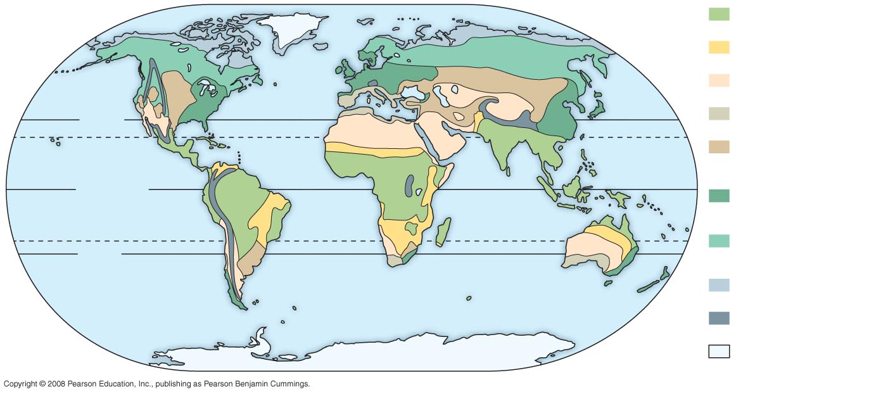
The distribution of major terrestrial biomes
Tropical forest
Savanna
Desert
30ºN
Chaparral
Tropic of
Cancer
Temperate
grassland
Equator
Temperate
broadleaf forest
Tropic of
Capricorn
Northern
coniferous forest
30ºS
Tundra
High mountains
Polar ice
Notes:
Figure 52.19 The distribution of major terrestrial biomes

Slide 17
General Features of Terrestrial Biomes and the Role of Disturbance
Terrestrial biomes are often named for major physical or climatic factors and for vegetation.
Terrestrial biomes usually grade into each other, without sharp boundaries.
The area of intergradation, called an ecotone, may be wide or narrow.
Terrestrial biomes can be characterized by distribution, precipitation, temperature, plants, and animals.

Slide 18
Vertical layering is an important feature of terrestrial biomes, and in a forest it might consist of an upper canopy, low-tree layer, shrub understory, ground layer of herbaceous plants, forest floor, and root layer.
Layering of vegetation in all biomes provides diverse habitats for animals.
Biomes are dynamic and usually exhibit extensive patchiness.

Slide 19
Biome Activity
Aquatic:
Freshwater Lake- Alyssa
Wetlands- Sarie
Intertidal Zone- Sebastian
Oceanic Pelagic Zone- Morgan O
Coral Reef- Ryan
Marine Benthic Zone- Eliana
Terrestrial:
Tropical Rainforest- Carmen
Desert- Morgan V
Savanna- David
Chapparal- Cayleigh
Temperate Grassland- Kira
Taiga- Alex
Temperate Broadleaf- Meg
Tundra- Audrey

Slide 20
Biome Activity
Terrestrial Biomes:
Identify annual rainfall
Annual Temperature
Seasonal changes
Predominant vegetation
Common animal species
Aquatic Biomes:
Describe physical environment (temperature, sunlight, etc)
Describe chemical environment (oxygen, nutrients, etc)
Photosynthetic organisms (autotrophs)
Common heterotrophs/animals

