Slide 1
Experimental Variables

Slide 2
Independent Variable
The variable you manipulate or change in an experiment
Practice:
You are testing whether or not giving chocolate to teachers decreases the amount of homework you receive. What is the independent variable?

Slide 3
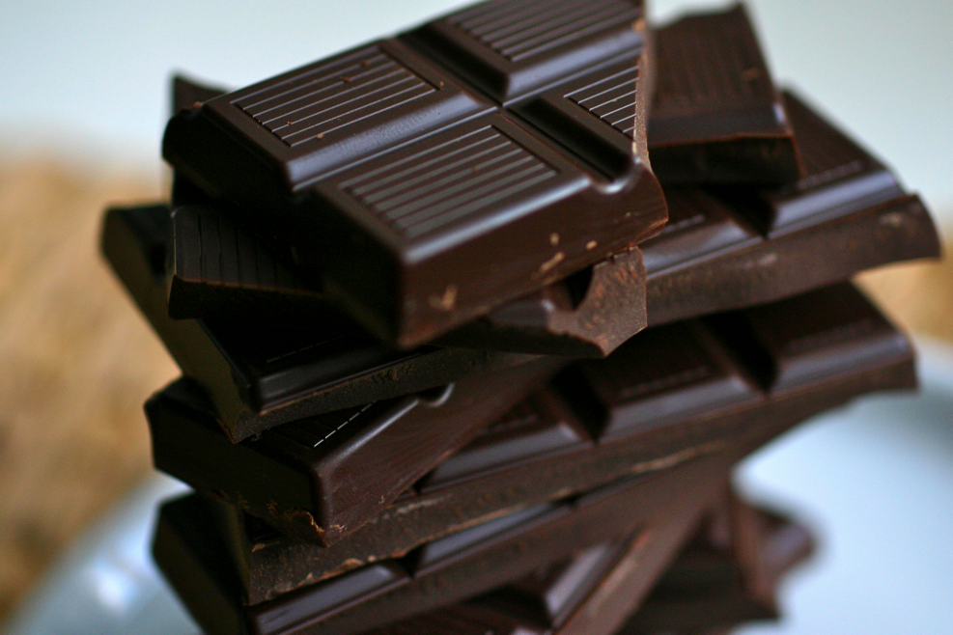
IV= Chocolate!

Slide 4
Dependent Variable
This is the variable you are measuring.
Practice:
You are testing whether or not giving chocolate to teachers decreases the amount of homework you receive. What is the dependent variable?

Slide 5
DV= Amount of Homework!

Slide 6
Constants
These are factors you keep the same to make sure your data is not affected.
Practice:
You are testing whether or not giving chocolate to teachers decreases the amount of homework you receive. What variables should you keep the same?

Slide 7
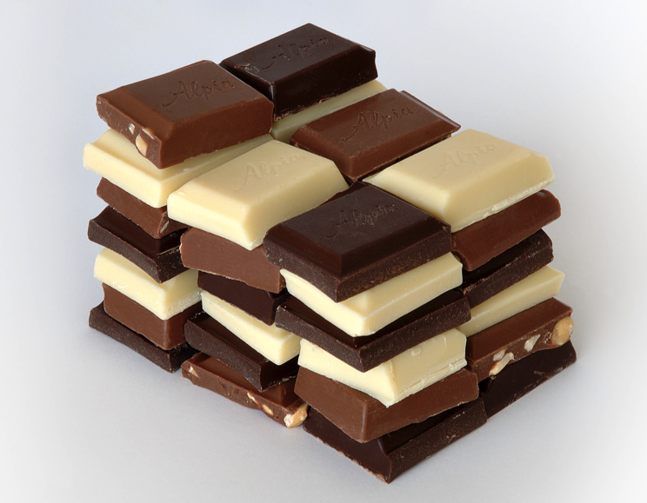
Constants: Amount of chocolate, type of chocolate, similar teachers/classes, how often chocolate is given etc.

Slide 8
Control
This is the group that you compare to. It either doesn’t get the independent variable or is in the normal condition.
Practice:
You are testing whether or not giving chocolate to teachers decreases the amount of homework you receive. What is the control?

Slide 9
Control= Teachers that don’t get chocolate

Slide 10
Sample
This is your test subject. The larger your sample, the more robust and meaningful your data is.
Practice:
You are testing whether or not giving chocolate to teachers decreases the amount of homework you receive. What is your sample?

Slide 11
Sample= Teachers

