Slide 1
Enzymes!

Slide 2
Enzymes speed up the rate of metabolic reactions by lowering energy barriers
A catalyst is a chemical agent that speeds up a reaction without being consumed by the reaction
An enzyme is a catalytic protein
Enzymes are specific. Enzymes have a shape-match with their substrates.
Enzymes are named after their substrate and generally end in -ase.
Hydrolysis of sucrose by the enzyme sucrase is an example of an enzyme-catalyzed reaction.
Copyright © 2008 Pearson Education, Inc., publishing as Pearson Benjamin Cummings

Slide 3
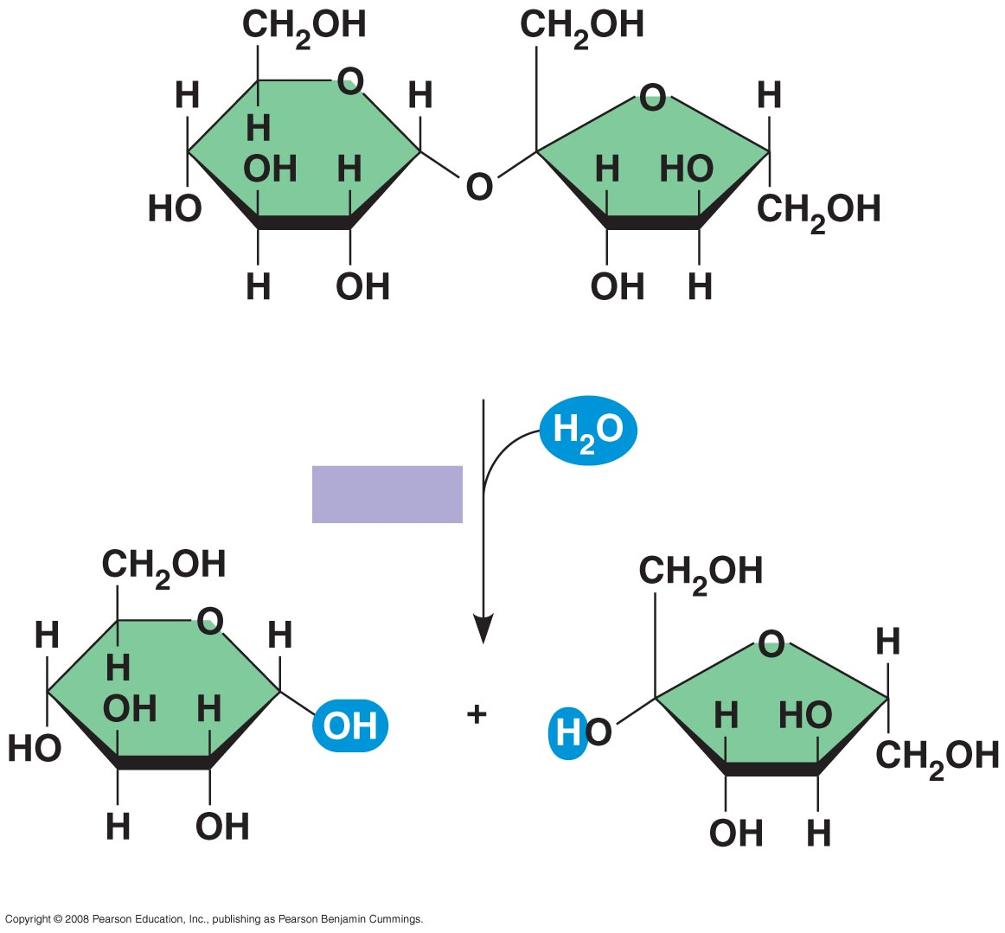
Example of an
enzyme-catalyzed
reaction:
hydrolysis of
sucrose by
sucrase
Sucrose (C₁₂H₂₂O₁₁)
Sucrase
Glucose (C₆H₁₂O₆)
Fructose (C₆H₁₂O₆)
Notes:
Figure 8.13

Slide 4
The Activation Energy E_{A} Barrier
Every chemical reaction between molecules involves bond breaking and bond forming.
The initial energy needed to start a chemical reaction is called the free energy of activation, or activation energy (E_{A})
Activation energy is often supplied in the form of heat from the surroundings.
Enzymes lower the amount of E_{A} needed, so the reaction rate is faster.
Copyright © 2008 Pearson Education, Inc., publishing as Pearson Benjamin Cummings

Slide 5
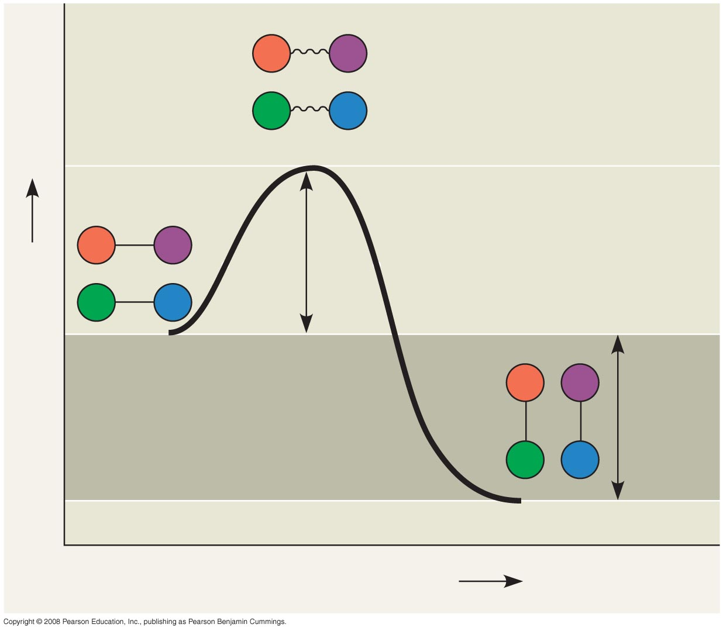
Exergonic
Reaction
A
B
C
D
Transition state
A
B
E_{A}
C
D
Free energy
Reactants
A
B
∆G < O
C
D
Products
Progress of the reaction
Notes:
Figure 8.14 Energy profile of an

Slide 6
How Enzymes Lower the E_{A} Barrier
Enzymes catalyze reactions by lowering the E_{A} barrier.
Enzymes do not affect the change in free energy (∆G); instead, they hasten / speed up reactions that would occur eventually.
Copyright © 2008 Pearson Education, Inc., publishing as Pearson Benjamin Cummings

Slide 7
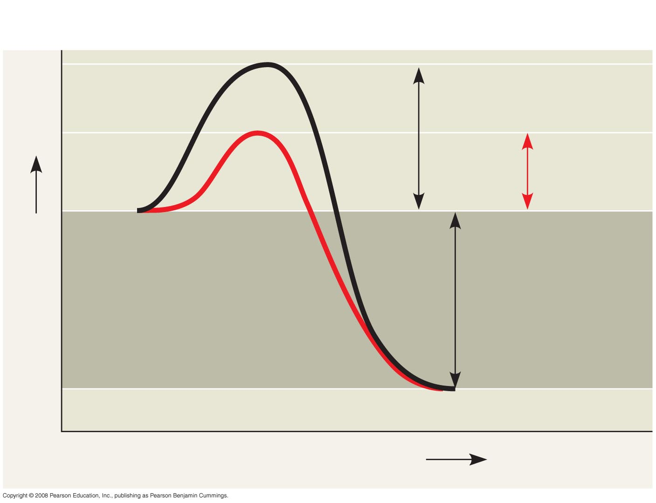
The effect of an enzyme on activation energy
Course of
reaction
without
enzyme
E_{A}
without
enzyme
E_{A} with
enzyme
is lower
Reactants
Free energy
Course of
reaction
with enzyme
∆G is unaffected
by enzyme
Products
Progress of the reaction
Notes:
Figure

Slide 8
Substrate Specificity of Enzymes
The reactant that an enzyme acts on is called the enzyme’s substrate.
The enzyme binds to its substrate, forming an enzyme-substrate complex (Reaction occurs)
The active site is the region on the enzyme where the substrate binds (shape match).
Induced fit of a substrate brings chemical groups of the active site into positions (orientation) that enhance their ability to catalyze the reaction.
Copyright © 2008 Pearson Education, Inc., publishing as Pearson Benjamin Cummings
Notes:
For the Cell Biology Video Closure of Hexokinase via Induced Fit, go to Animation and Video Files.

Slide 9
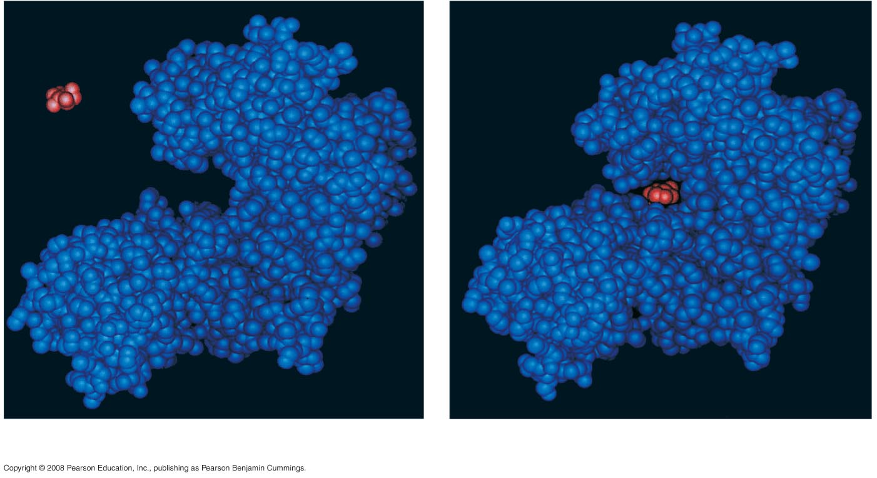
Induced fit between an enzyme and its substrate
Substrate
Active site
Enzyme
Enzyme-substrate
complex
(a)
(b)
Notes:
Figure 8.16

Slide 10
Catalysis in the Enzyme’s Active Site
In an enzymatic reaction, the substrate binds to the active site of the enzyme
The enzyme’s active site can lower an E_{A} barrier by
Orienting substrates correctly
Straining substrate bonds / tension
Providing a favorable microenvironment
Covalently bonding to the substrate
Copyright © 2008 Pearson Education, Inc., publishing as Pearson Benjamin Cummings

Slide 11
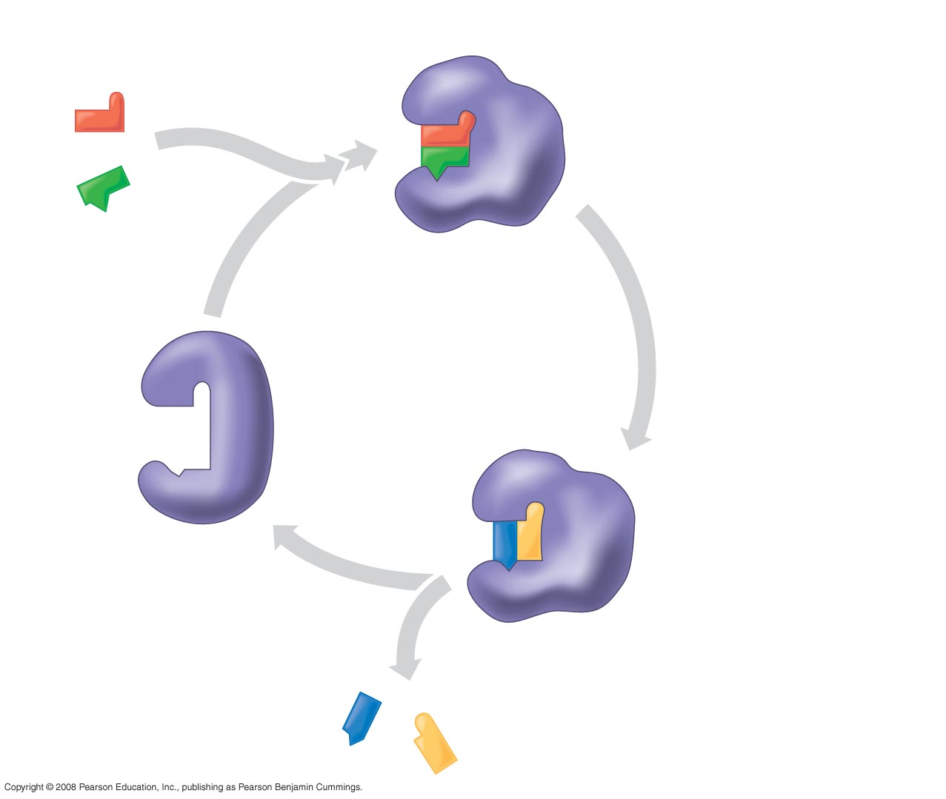
Substrates enter active site; enzyme
changes shape such that its active site
enfolds the substrates (induced fit).
1
2
Substrates held in
active site by weak
interactions, such as
hydrogen bonds and
ionic bonds.
Substrates
Enzyme-substrate
Complex:
Reaction occurs
Active site can lower E_{A}
and speed up a reaction.
3
6
Active
site is
available
for two new
substrate
molecules.
Enzyme
5
Products are
released.
4
Substrates are
converted to
products.
Products
Notes:
Figure 8.17 The active site and catalytic cycle of an enzyme

Slide 12
Effects of Local Conditions on Enzyme Activity
An enzyme’s activity / reaction rate / can be affected by environmental factors such as:
temperature, pH, and concentration of enzyme or substrate.
Chemicals that specifically influence the enzyme.
Copyright © 2008 Pearson Education, Inc., publishing as Pearson Benjamin Cummings

Slide 13
Effects of Temperature and pH
Each enzyme has an optimal temperature in which it functions best / forming the maximum enzyme-substrate complexes --> highest rate of reaction.
Each enzyme has an optimal pH in which it functions best / forming the maximum enzyme-substrate complexes --> highest rate of reaction.
Copyright © 2008 Pearson Education, Inc., publishing as Pearson Benjamin Cummings

Slide 14
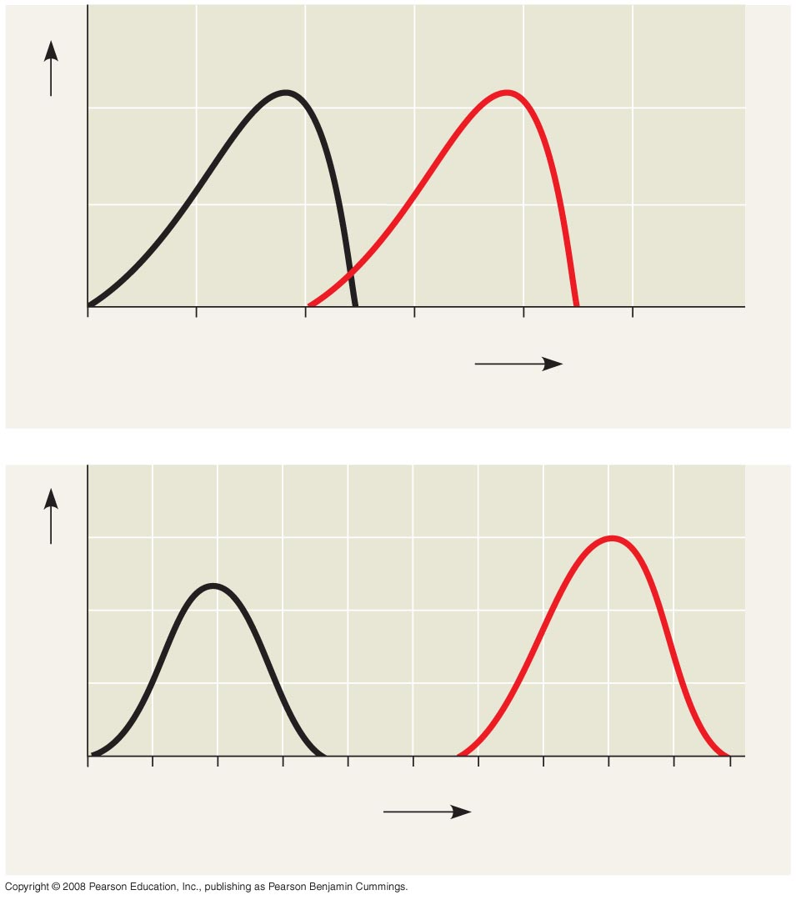
Environmental
factors
affecting
enzyme activity
Optimal temperature for
typical human enzyme
Optimal temperature for
enzyme of thermophilic
(heat-tolerant)
bacteria
Rate of reaction
0
20
40
60
80
100
Temperature (ºC)
(a) Optimal temperature for two enzymes
Optimal pH for pepsin
(stomach enzyme)
Optimal pH
for trypsin
(intestinal
enzyme)
Rate of reaction
0
1
2
3
4
5
6
7
8
9
10
pH
(b) Optimal pH for two enzymes
Notes:
Figure 8.18

Slide 15
Cofactors:
Affect enzyme action
Cofactors are nonprotein enzyme helpers.
Cofactors may be inorganic (such as a metal in ionic form) or organic.
Organic cofactors are called coenzymes.
Coenzymes include vitamins.
Inorganic cofactors include minerals and salts.
Copyright © 2008 Pearson Education, Inc., publishing as Pearson Benjamin Cummings

Slide 16
Enzyme Inhibitors
Competitive inhibitors bind to the active site of an enzyme, competing with the substrate.
Noncompetitive inhibitors bind to another part of an enzyme, causing the enzyme to change shape and making the active site less able to bind with the substrate.
Examples of inhibitors include toxins, poisons, pesticides, and antibiotics.
Copyright © 2008 Pearson Education, Inc., publishing as Pearson Benjamin Cummings

Slide 17
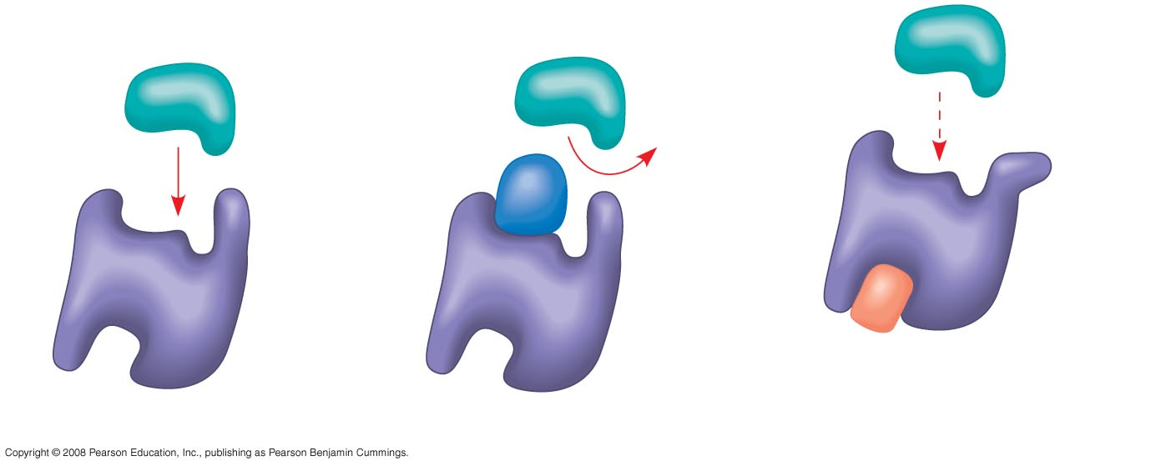
Inhibition of enzyme activity
Substrate
Active site
Competitive
inhibitor
Enzyme
Noncompetitive inhibitor
(a) Normal binding
(b) Competitive inhibition
(c) Noncompetitive inhibition
Notes:
Figure 8.19

Slide 18
Regulation of enzyme activity helps control metabolism
Chemical chaos would result if a cell’s metabolic pathways were not tightly regulated.
A cell regulates metabolism by:
switching on or off the genes that encode specific enzymes.
or by regulating the activity of enzymes.
Copyright © 2008 Pearson Education, Inc., publishing as Pearson Benjamin Cummings

Slide 19
Allosteric Regulation of Enzymes
Allosteric regulation may either inhibit or stimulate an enzyme’s activity.
Allosteric regulation occurs when a regulatory molecule binds to a protein at one site and affects the protein’s function at another site.
Copyright © 2008 Pearson Education, Inc., publishing as Pearson Benjamin Cummings

Slide 20
Allosteric Activation and Inhibition
Most allosterically regulated enzymes are made from polypeptide subunits.
Each enzyme has active and inactive forms.
The binding of an activator stabilizes the active form of the enzyme.
The binding of an inhibitor stabilizes the inactive form of the enzyme.
Copyright © 2008 Pearson Education, Inc., publishing as Pearson Benjamin Cummings

Slide 21
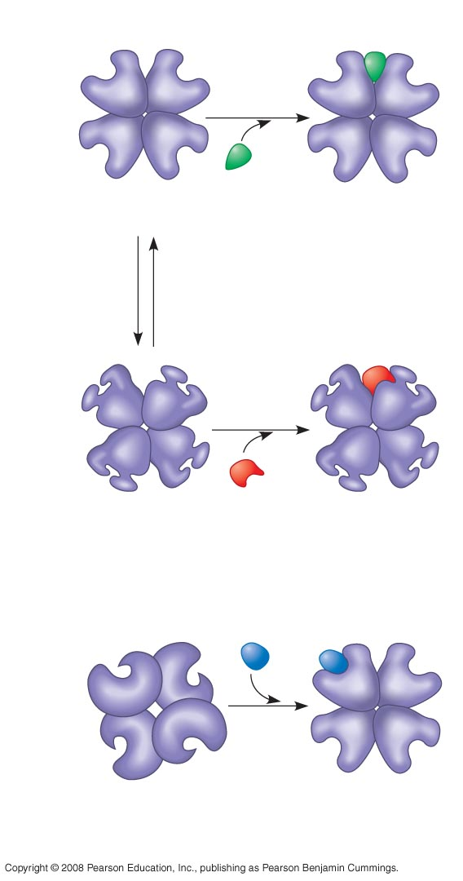
Allosteric
Regulation of
enzyme activity
Allosteric enyzme
with four subunits
Active site
(one of four)
Regulatory
site (one
of four)
Activator
Active form
Stabilized active form
Oscillation
Non-
functional
active
site
Inactive form
Inhibitor
Stabilized inactive
form
(a) Allosteric activators and inhibitors
Substrate
Inactive form
Stabilized active
form
(b) Cooperativity: another type of allosteric activation
Notes:
Figure 8.20

Slide 22
Cooperativity is a form of allosteric regulation that can amplify enzyme activity.
In cooperativity, binding by a substrate to one active site stabilizes favorable conformational changes at all other subunits.
Copyright © 2008 Pearson Education, Inc., publishing as Pearson Benjamin Cummings

Slide 23
Identification of Allosteric Regulators
Allosteric regulators are attractive drug candidates for enzyme regulation.
Inhibition of proteolytic enzymes called caspases may help management of inappropriate inflammatory responses.
Copyright © 2008 Pearson Education, Inc., publishing as Pearson Benjamin Cummings

Slide 24
Feedback Inhibition: Allosteric Enzyme Regulation
In feedback inhibition, the end product of a metabolic pathway shuts down the pathway. End product builds up and becomes and allosteric inhibitor.
Allosteric inhibitor binds to an allosteric enzyme early in the pathway, shutting down the pathway.
Feedback inhibition prevents a cell from wasting chemical resources by synthesizing more product than is needed.
Copyright © 2008 Pearson Education, Inc., publishing as Pearson Benjamin Cummings

Slide 25
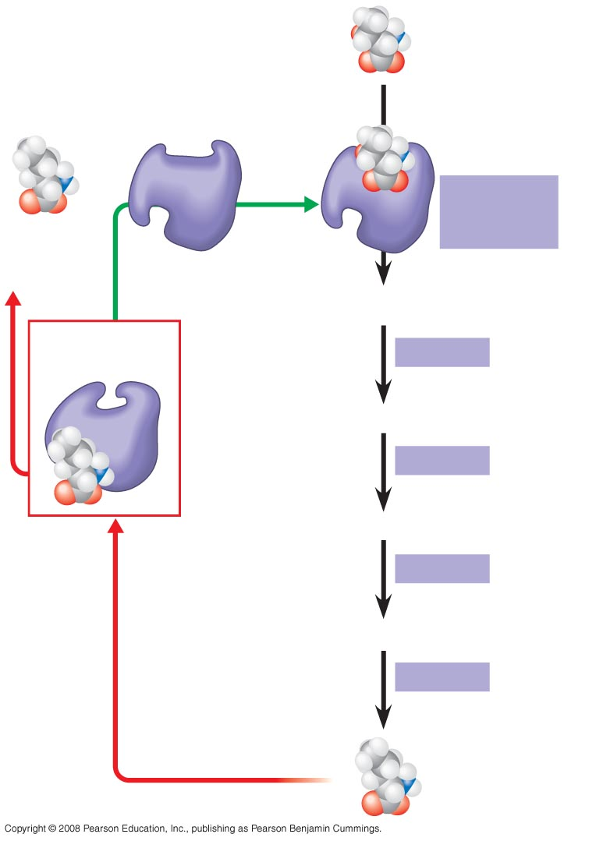
Feedback Inhibition
Initial substrate
(threonine)
Active site
available
Threonine
in active site
Enzyme 1
(threonine
deaminase)
Isoleucine
used up by
cell
Intermediate A
Feedback
inhibition
Enzyme 2
Active site of
enzyme 1 no
longer binds
threonine;
pathway is
switched off.
Intermediate B
Enzyme 3
Isoleucine
binds to
allosteric
site
Intermediate C
Enzyme 4
Intermediate D
Enzyme 5
End product
(isoleucine)
Notes:
Figure 8.22 Feedback inhibition in isoleucine synthesis

