Slide 1
Ecology

Slide 2
Overview: The Scope of Ecology
Ecology is the scientific study of the interactions between organisms and the environment.
Ecologists work at levels ranging from individual organisms to the planet / biosphere.
Ecology integrates all areas of biological research and informs environmental decision making.

Slide 3
Organismal ecology studies how an organism’s structure, physiology, and (for animals) behavior meet environmental challenges … Adaptations …
A population is a group of individuals of the same species living in an area.
Population ecology focuses on factors affecting how many individuals of a species live in an area.

Slide 4
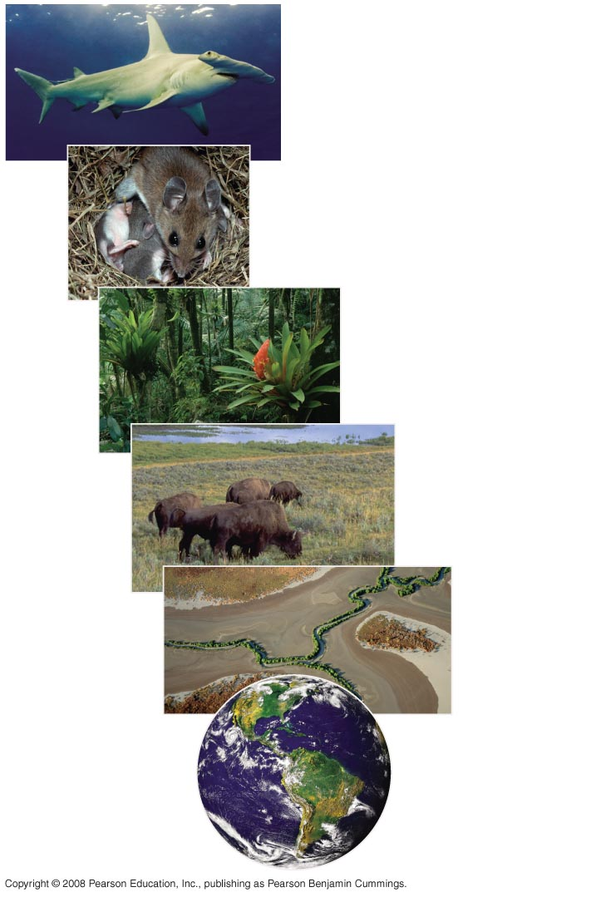
Scope of Ecological Research
Organismal
ecology
Population
ecology
Community
ecology
Ecosystem
ecology
Landscape
ecology
Global / Biosphere
ecology
Notes:
Figure 52.2 The scope of ecological research

Slide 5
A community is a group of populations of different species in an area.
Community ecology deals with the whole array of interacting species in a community.
An ecosystem is the community of organisms in an area and the physical factors with which they interact.
Ecosystem ecology emphasizes energy flow and chemical cycling among the various biotic and abiotic components.

Slide 6
A landscape is a mosaic of connected ecosystems.
Landscape ecology deals with arrays of ecosystems and how they are arranged in a geographic region.
The biosphere is the global ecosystem, the sum of all the planet’s ecosystems.
Global ecology examines the influence of energy and materials on organisms across the biosphere.

Slide 7
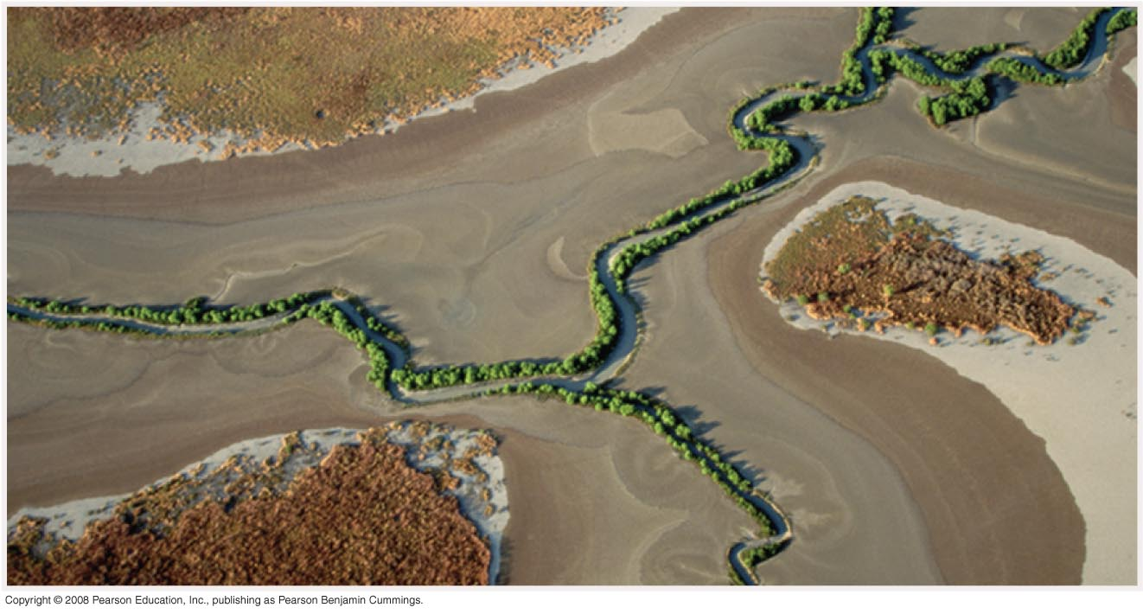
Lanscape Ecology: Interacting Ecosystems
Notes:
Figure 52.2 The scope of ecological research

Slide 8
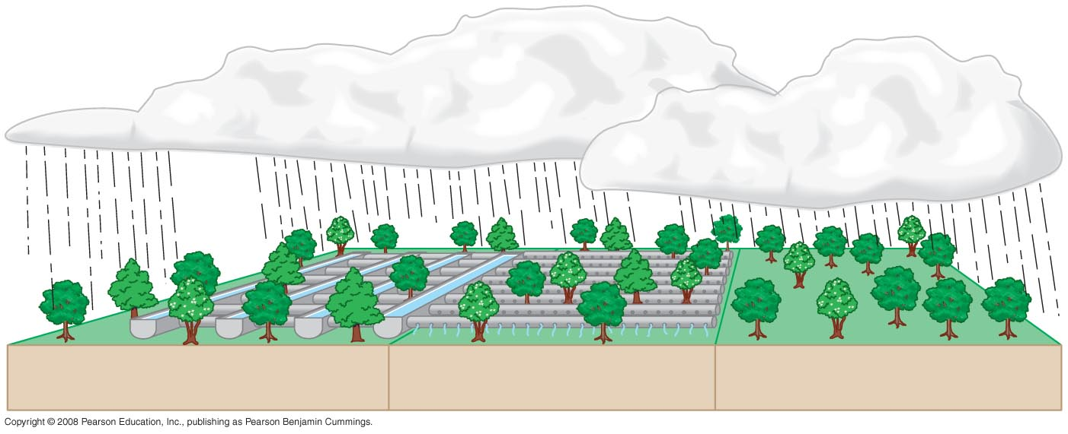
Scienctific Methodolgy Integrates Many Areas of Research: Studying how a forest responds to altered precipitation
Trough
Pipe
“Dry”
“Wet”
“Ambient”
Notes:
Figure 52.3 Studying how a forest responds to altered precipitation

Slide 9
Ecology, Environmental Issues, & Evolution Link
Events that occur in ecological time affect life on the scale of evolutionary time.
Ecology provides the scientific understanding that underlies environmental issues.
Ecologists make a distinction between science and advocacy (action proposals based on knowledge).
Rachel Carson is credited with starting the modern environmental movement with the publication of Silent Spring in 1962.

Slide 10
Interactions between organisms and the environment limit the distribution of species
Ecologists have long recognized global and regional patterns of distribution of organisms within the biosphere.
Biogeography is a good starting point for understanding what limits geographic distribution of species.
Ecologists recognize two kinds of factors that determine distribution: biotic = living factors, and abiotic = nonliving factors / physical environment.

Slide 11
Global Climate Patterns
Global climate patterns are determined largely by solar energy and the planet’s movement in space.
Sunlight intensity plays a major part in determining the Earth’s climate patterns.
More heat and light per unit of surface area reach the tropics than the high latitudes.

Slide 12
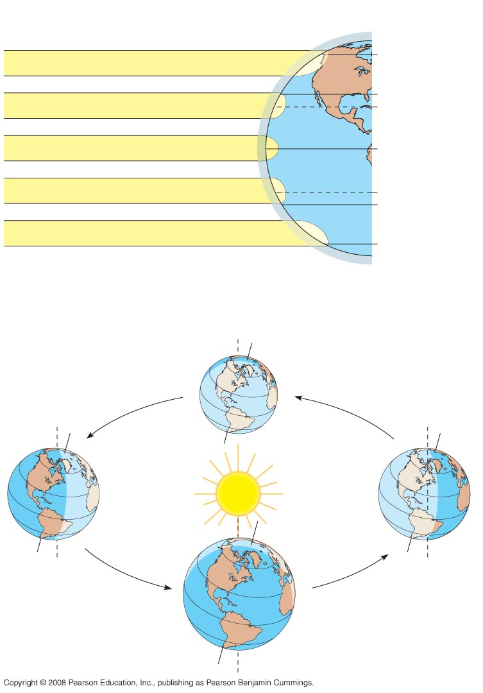
Global climate patterns: How direct or slanted - the sun’s rays … Impacts Climate. The Strength of Sun’s Rays in an area varies seasonally as Earth Orbits Sun.
Latitudinal Variation in Sunlight Intensity
90ºN (North Pole)
Low angle of incoming sunlight
60ºN
30ºN
23.5ºN (Tropic of
Cancer)
Sun directly overhead at equinoxes
0º (equator)
23.5ºS (Tropic of
Capricorn)
30ºS
Low angle of incoming sunlight
60ºS
90ºS (South Pole)
Atmosphere
Seasonal Variation in Sunlight Intensity
60ºN
30ºN
March equinox
0º (equator)
June solstice
30ºS
Constant tilt
of 23.5º
December solstice
September equinox
Notes:
Figure 52.10 Global climate patterns

Slide 13
Air flowing close to Earth’s surface creates predictable global wind patterns.
Cooling trade winds blow from east to west in the tropics; prevailing westerlies blow from west to east in the temperate zones.
Proximity to bodies of water and topographic features contribute to local variations in climate.
Seasonal variation also influences climate.

Slide 14
