Slide 1
Chemistry of Life

Slide 2
Overview: A Chemical Connection to Biology
Biology is a multidisciplinary science.
Living organisms are subject to basic laws of physics and chemistry.
Copyright © 2008 Pearson Education, Inc., publishing as Benjamin Cummings

Slide 3
Matter consists of chemical elements in pure form and in combinations called compounds
Organisms are composed of matter.
Matter is anything that takes up space and has mass.
Copyright © 2008 Pearson Education, Inc., publishing as Benjamin Cummings

Slide 4
Elements and Compounds
Matter is made up of elements.
An element is a substance that cannot be broken down to other substances by chemical reactions.
A compound is a substance consisting of two or more elements in a fixed ratio.
A compound has characteristics different from those of its elements.
Copyright © 2008 Pearson Education, Inc., publishing as Benjamin Cummings

Slide 5
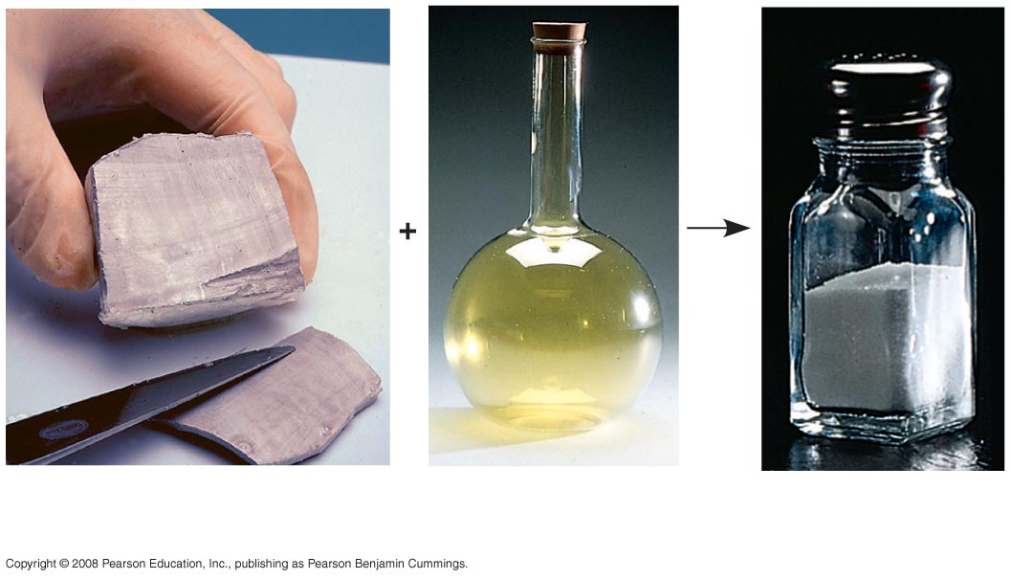
The emergent properties of a compound
Sodium
Chlorine
Sodium
chloride
Notes:
Figure 2.3 The emergent properties of a compound

Slide 6
Essential Elements of Life: C H O N
About 25 of the 92 elements are essential to life.
Carbon, hydrogen, oxygen, and nitrogen make up 96% of living matter.
Most of the remaining 4% consists of calcium, phosphorus, potassium, and sulfur.
Trace elements are those required by an organism in minute quantities.
Copyright © 2008 Pearson Education, Inc., publishing as Benjamin Cummings

Slide 7
An element’s properties depend on the structure of its atoms
Each element consists of unique atoms.
An atom is the smallest unit of matter that still retains the properties of an element.
Copyright © 2008 Pearson Education, Inc., publishing as Benjamin Cummings

Slide 8
Subatomic Particles
Atoms are composed of subatomic particles.
Relevant subatomic particles include:
Neutrons (no electrical charge)
Protons (positive charge)
Electrons (negative charge).
Copyright © 2008 Pearson Education, Inc., publishing as Benjamin Cummings

Slide 9
Simplified models of a helium (He) atom
Cloud of negative
charge (2 electrons)
Electrons
Nucleus
(a)
(b)
Notes:
Figure 2.5 Simplified models of a helium (He) atom

Slide 10
Atomic Number and Atomic Mass
An element’s atomic number = # protons, the number of protons in its nucleus.
An element’s mass number = p + n, sum of protons plus neutrons in the nucleus.
Atomic mass, the atom’s total mass, can be approximated by the mass number.
Copyright © 2008 Pearson Education, Inc., publishing as Benjamin Cummings

Slide 11
Isotopes
All atoms of an element have the same number of protons but may differ in number of neutrons
Isotopes are two atoms of an element that differ in number of neutrons.
Copyright © 2008 Pearson Education, Inc., publishing as Benjamin Cummings

Slide 12
The Energy Levels of Electrons
Energy is the capacity to cause change.
Potential energy is the energy that matter has because of its location or structure.
The electrons of an atom differ in their amounts of potential energy.
An electron’s state of potential energy is called its energy level, or electron shell.
Copyright © 2008 Pearson Education, Inc., publishing as Benjamin Cummings

Slide 13
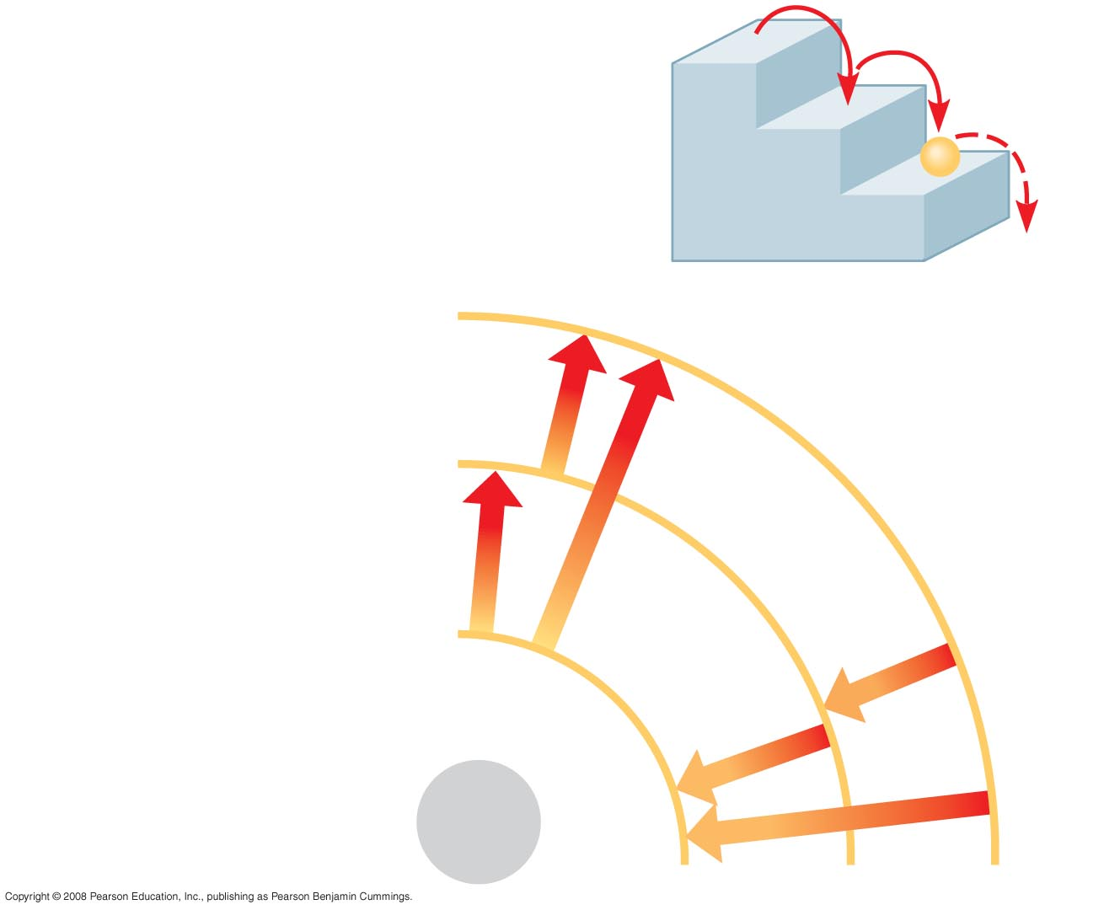
Energy levels of an atom’s electrons
(a) A ball bouncing down a flight
of stairs provides an analogy
for energy levels of electrons
Third shell (highest energy
level)
Second shell (higher
energy level)
Energy
absorbed
First shell (lowest energy
level)
Energy
lost
Atomic
nucleus
(b)
Notes:
Figure 2.8 Energy levels of an atom’s electrons

Slide 14
Electron Distribution and Chemical Properties
The chemical behavior of an atom is determined by the distribution of electrons in electron shells.
The periodic table of the elements shows the electron distribution for each element.
Copyright © 2008 Pearson Education, Inc., publishing as Benjamin Cummings

Slide 15
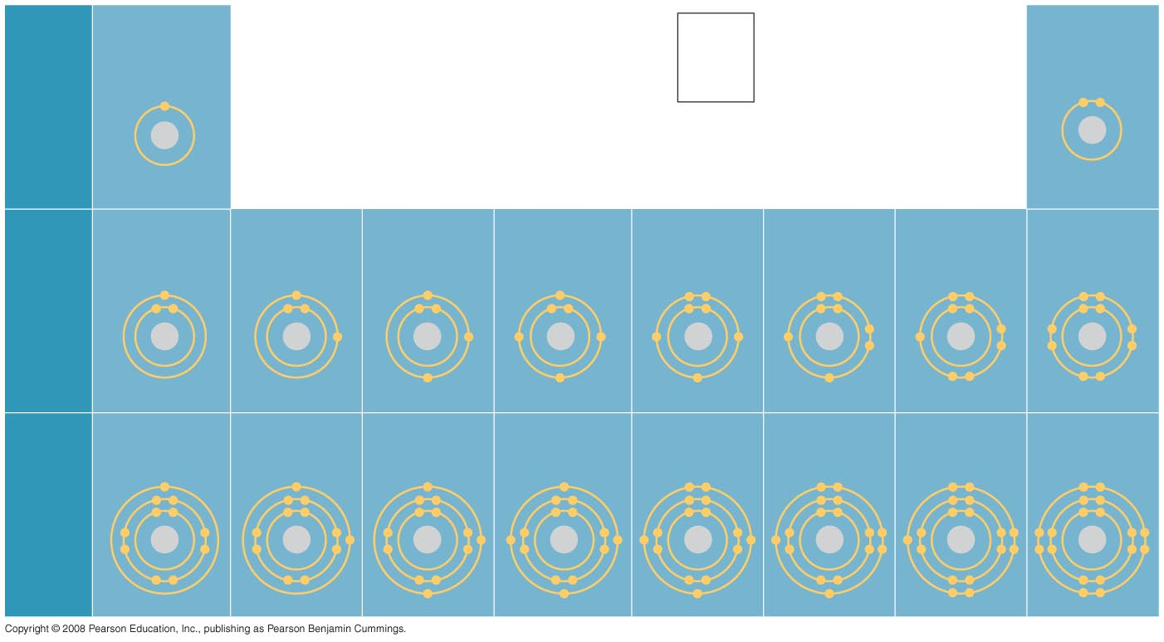
Electron-distribution diagrams for the first 18 elements in the periodic table
Hydrogen
₁H
2
Atomic number
Helium
₂He
He
First
shell
Atomic mass
4.00
Element symbol
Electron-
distribution
diagram
Lithium
₃Li
Beryllium
₄Be
Boron
₅B
Carbon
₆C
Nitrogen
₇N
Oxygen
₈O
Fluorine
₉F
Neon
₁₀Ne
Second
shell
Sodium
₁₁Na
Magnesium
₁₂Mg
Aluminum
₁₃Al
Silicon
₁₄Si
Phosphorus
₁₅P
Sulfur
₁₆S
Chlorine
₁₇Cl
Argon
₁₈Ar
Third
shell
Notes:
Figure 2.9 Electron-distribution diagrams for the first 18 elements in the periodic table

Slide 16
Valence electrons are those in the outermost shell, or valence shell.
The chemical behavior of an atom is mostly determined by the valence electrons.
Elements with a full valence shell are chemically inert. (noble gases)
Copyright © 2008 Pearson Education, Inc., publishing as Benjamin Cummings

Slide 17
Electron Orbitals
An orbital is the three-dimensional space where an electron is found 90% of the time.
Each electron shell consists of a specific number of orbitals.
Copyright © 2008 Pearson Education, Inc., publishing as Benjamin Cummings

Slide 18
The formation and function of molecules depend on chemical bonding between atoms
Atoms with incomplete valence shells can share or transfer valence electrons with certain other atoms in order to become stable.
These interactions usually result in atoms staying close together, held by attractions called chemical bonds.
Copyright © 2008 Pearson Education, Inc., publishing as Benjamin Cummings

Slide 19
Covalent Bonds - Share pairs of electrons
A covalent bond is the sharing of a pair of valence electrons by two atoms.
In a covalent bond, the shared electrons count as part of each atom’s valence shell.
Copyright © 2008 Pearson Education, Inc., publishing as Benjamin Cummings

Slide 20
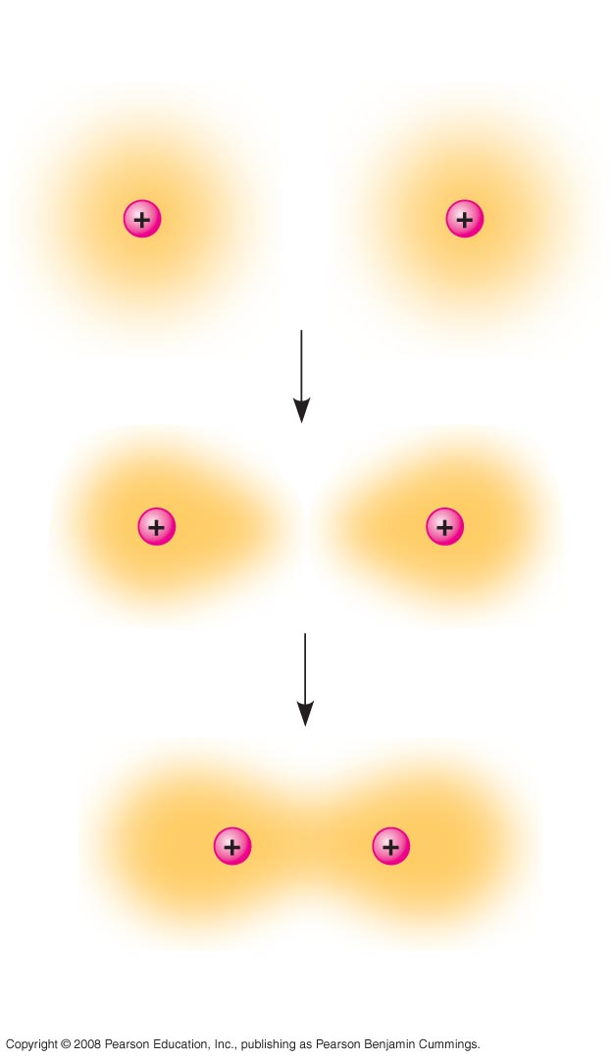
Formation of
covalent bond
Hydrogen
atoms (2 H)
Hydrogen
molecule (H₂)
Notes:
Figure 2.11 Formation of a covalent bond

Slide 21
A molecule consists of two or more atoms held together by covalent bonds.
A single covalent bond, or single bond, is the sharing of one pair of valence electrons.
A double covalent bond, or double bond, is the sharing of two pairs of valence electrons.
Copyright © 2008 Pearson Education, Inc., publishing as Benjamin Cummings

Slide 22
The notation used to represent atoms and bonding is called a structural formula.
For example, H–H
This can be abbreviated further with a molecular formula.
For example, H₂
Copyright © 2008 Pearson Education, Inc., publishing as Benjamin Cummings

Slide 23
Covalent bonding in Water Molecules
Name and
Molecular
Formula
Electron-
distribution
Diagram
Lewis Dot
Structure and
Structural
Formula
Space-
filling
Model
Water (H₂O)
Notes:
Figure 2.12 Covalent bonding in four molecules

Slide 24
Electronegativity is an atom’s attraction for the electrons in a covalent bond.
The more electronegative an atom, the more strongly it pulls shared electrons toward itself.
Copyright © 2008 Pearson Education, Inc., publishing as Benjamin Cummings

Slide 25
In a nonpolar covalent bond, the atoms share the electron equally.
In a polar covalent bond, one atom is more electronegative, and the atoms share the electron unequally.
Unequal sharing of electrons causes a partial positive or negative charge for each atom or molecule.
Copyright © 2008 Pearson Education, Inc., publishing as Benjamin Cummings

Slide 26
Ionic Bonds: Transfer electrons
Atoms sometimes strip electrons from their bonding partners.
An example is the transfer of an electron from sodium to chlorine.
After the transfer of an electron, both atoms have charges.
A charged atom (or molecule) is called an ion.
Copyright © 2008 Pearson Education, Inc., publishing as Benjamin Cummings

Slide 27
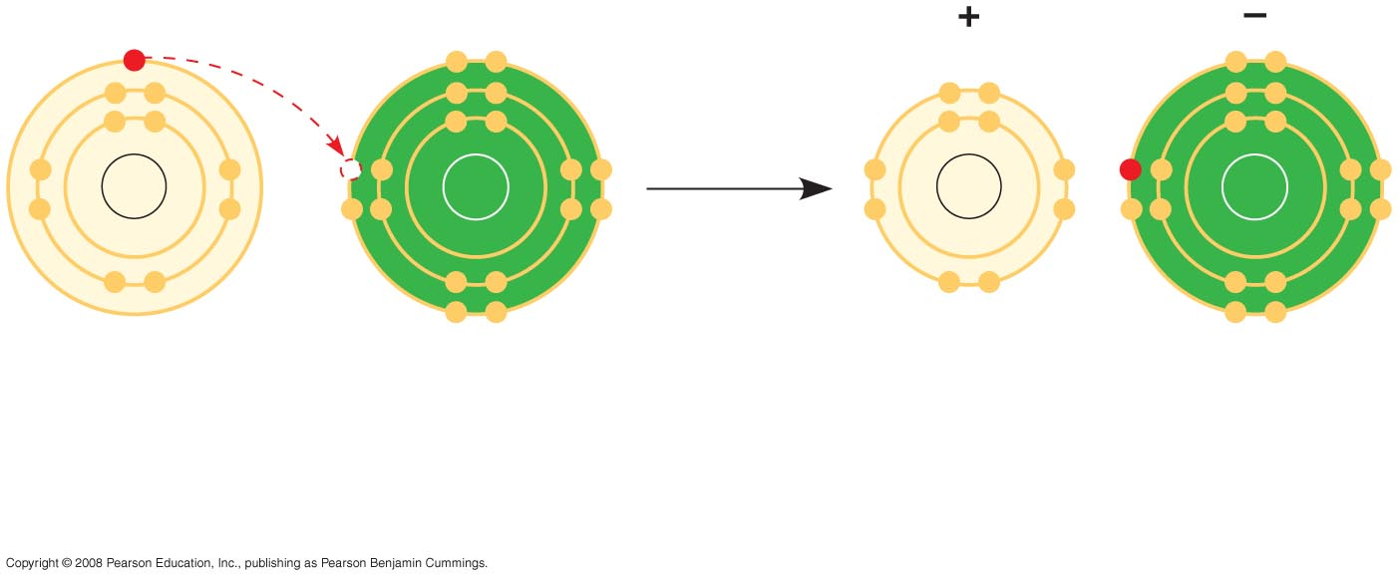
Electron transfer and ionic bonding
Na
Cl
Na
Cl
Na
Cl
Na⁺
Cl–
Sodium atom
Chlorine atom
Sodium ion
(a cation)
Chloride ion
(an anion)
Sodium chloride (NaCl)
Notes:
Figure 2.14 Electron transfer and ionic bonding

Slide 28
A cation is a positively + charged ion.
An anion is a negatively - charged ion.
An ionic bond is an attraction between an anion and a cation.
Compounds formed by ionic bonds are called ionic compounds, or salts.
Salts, such as sodium chloride (table salt), are often found in nature as crystals.
Copyright © 2008 Pearson Education, Inc., publishing as Benjamin Cummings

Slide 29
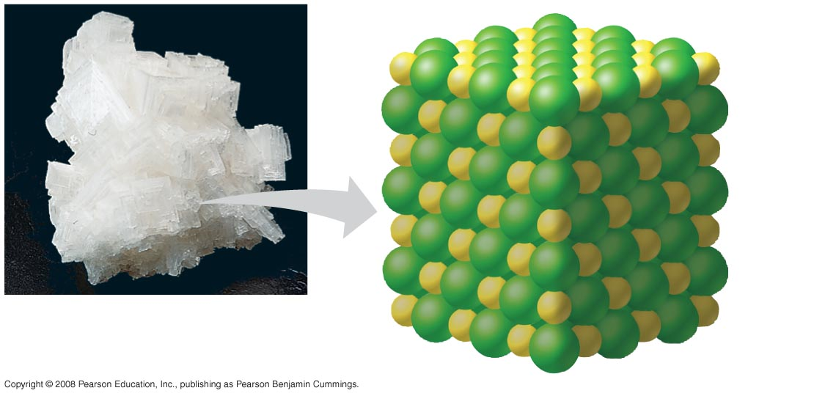
A sodium chloride crystal
Na⁺
Cl–
Notes:
Figure 2.15 A sodium chloride crystal

Slide 30
Weak Chemical Bonds
Most of the strongest bonds in organisms are covalent bonds that form a cell’s molecules.
Weak chemical bonds, such as ionic bonds and hydrogen bonds, are also important.
Weak chemical bonds reinforce shapes of large molecules and help molecules adhere to each other.
Copyright © 2008 Pearson Education, Inc., publishing as Benjamin Cummings

Slide 31
Hydrogen Bonds
A hydrogen bond forms when a hydrogen atom covalently bonded to one electronegative atom is also attracted to another electronegative atom.
In living cells, the electronegative partners are usually oxygen or nitrogen atoms.
Copyright © 2008 Pearson Education, Inc., publishing as Benjamin Cummings

Slide 32
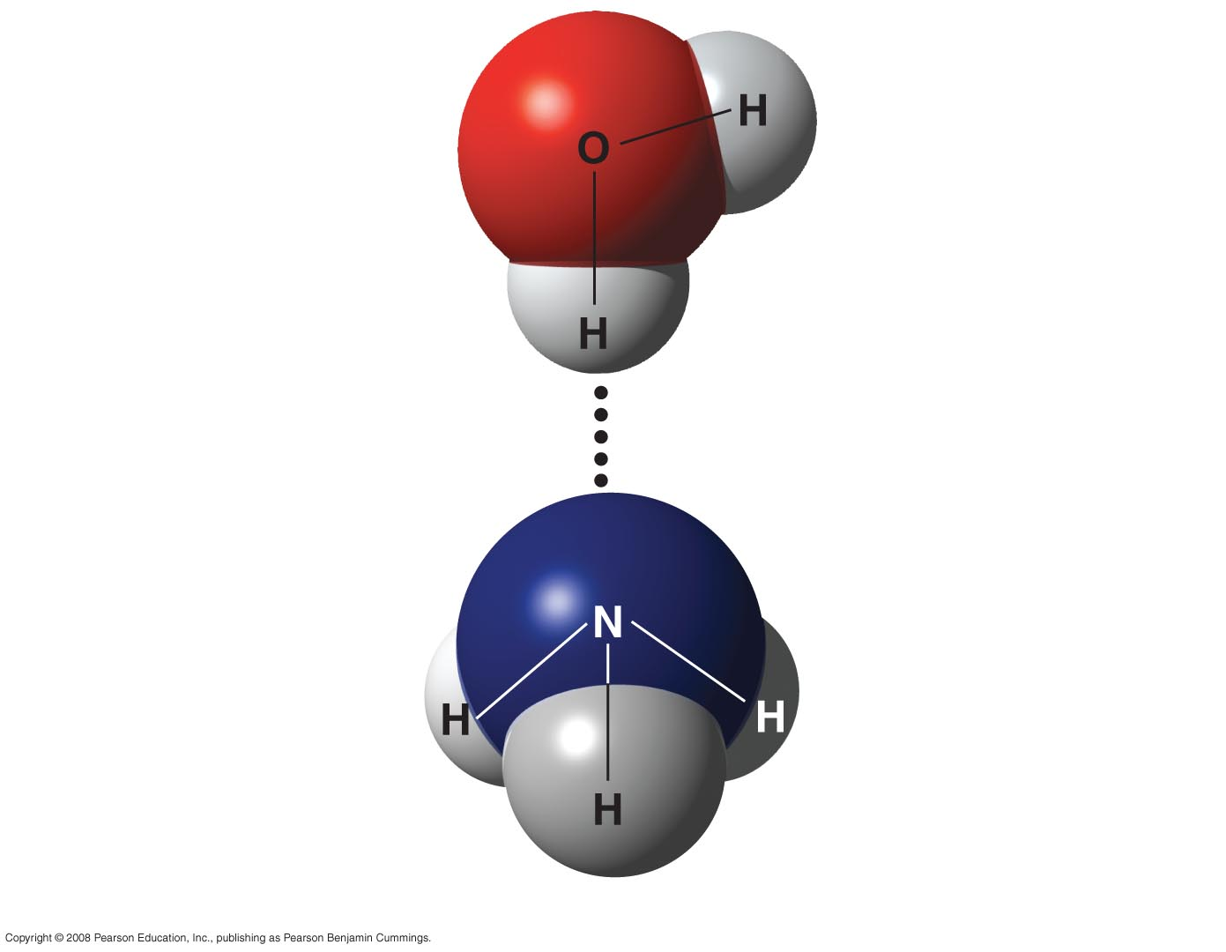
Hydrogen bond
δ −
δ+
Water (H₂O)
δ+
Hydrogen bond
δ −
Ammonia (NH₃)
δ+
δ+
δ+
Notes:
Figure 2.16 A hydrogen bond

Slide 33
Van der Waals Interactions
If electrons are distributed asymmetrically in molecules or atoms, they can result in “hot spots” of positive or negative charge.
Van der Waals interactions are attractions between molecules that are close together as a result of these charges.
Collectively, such interactions can be strong, as between molecules of a gecko’s toe hairs and a wall surface.
Copyright © 2008 Pearson Education, Inc., publishing as Benjamin Cummings

